Slide 1
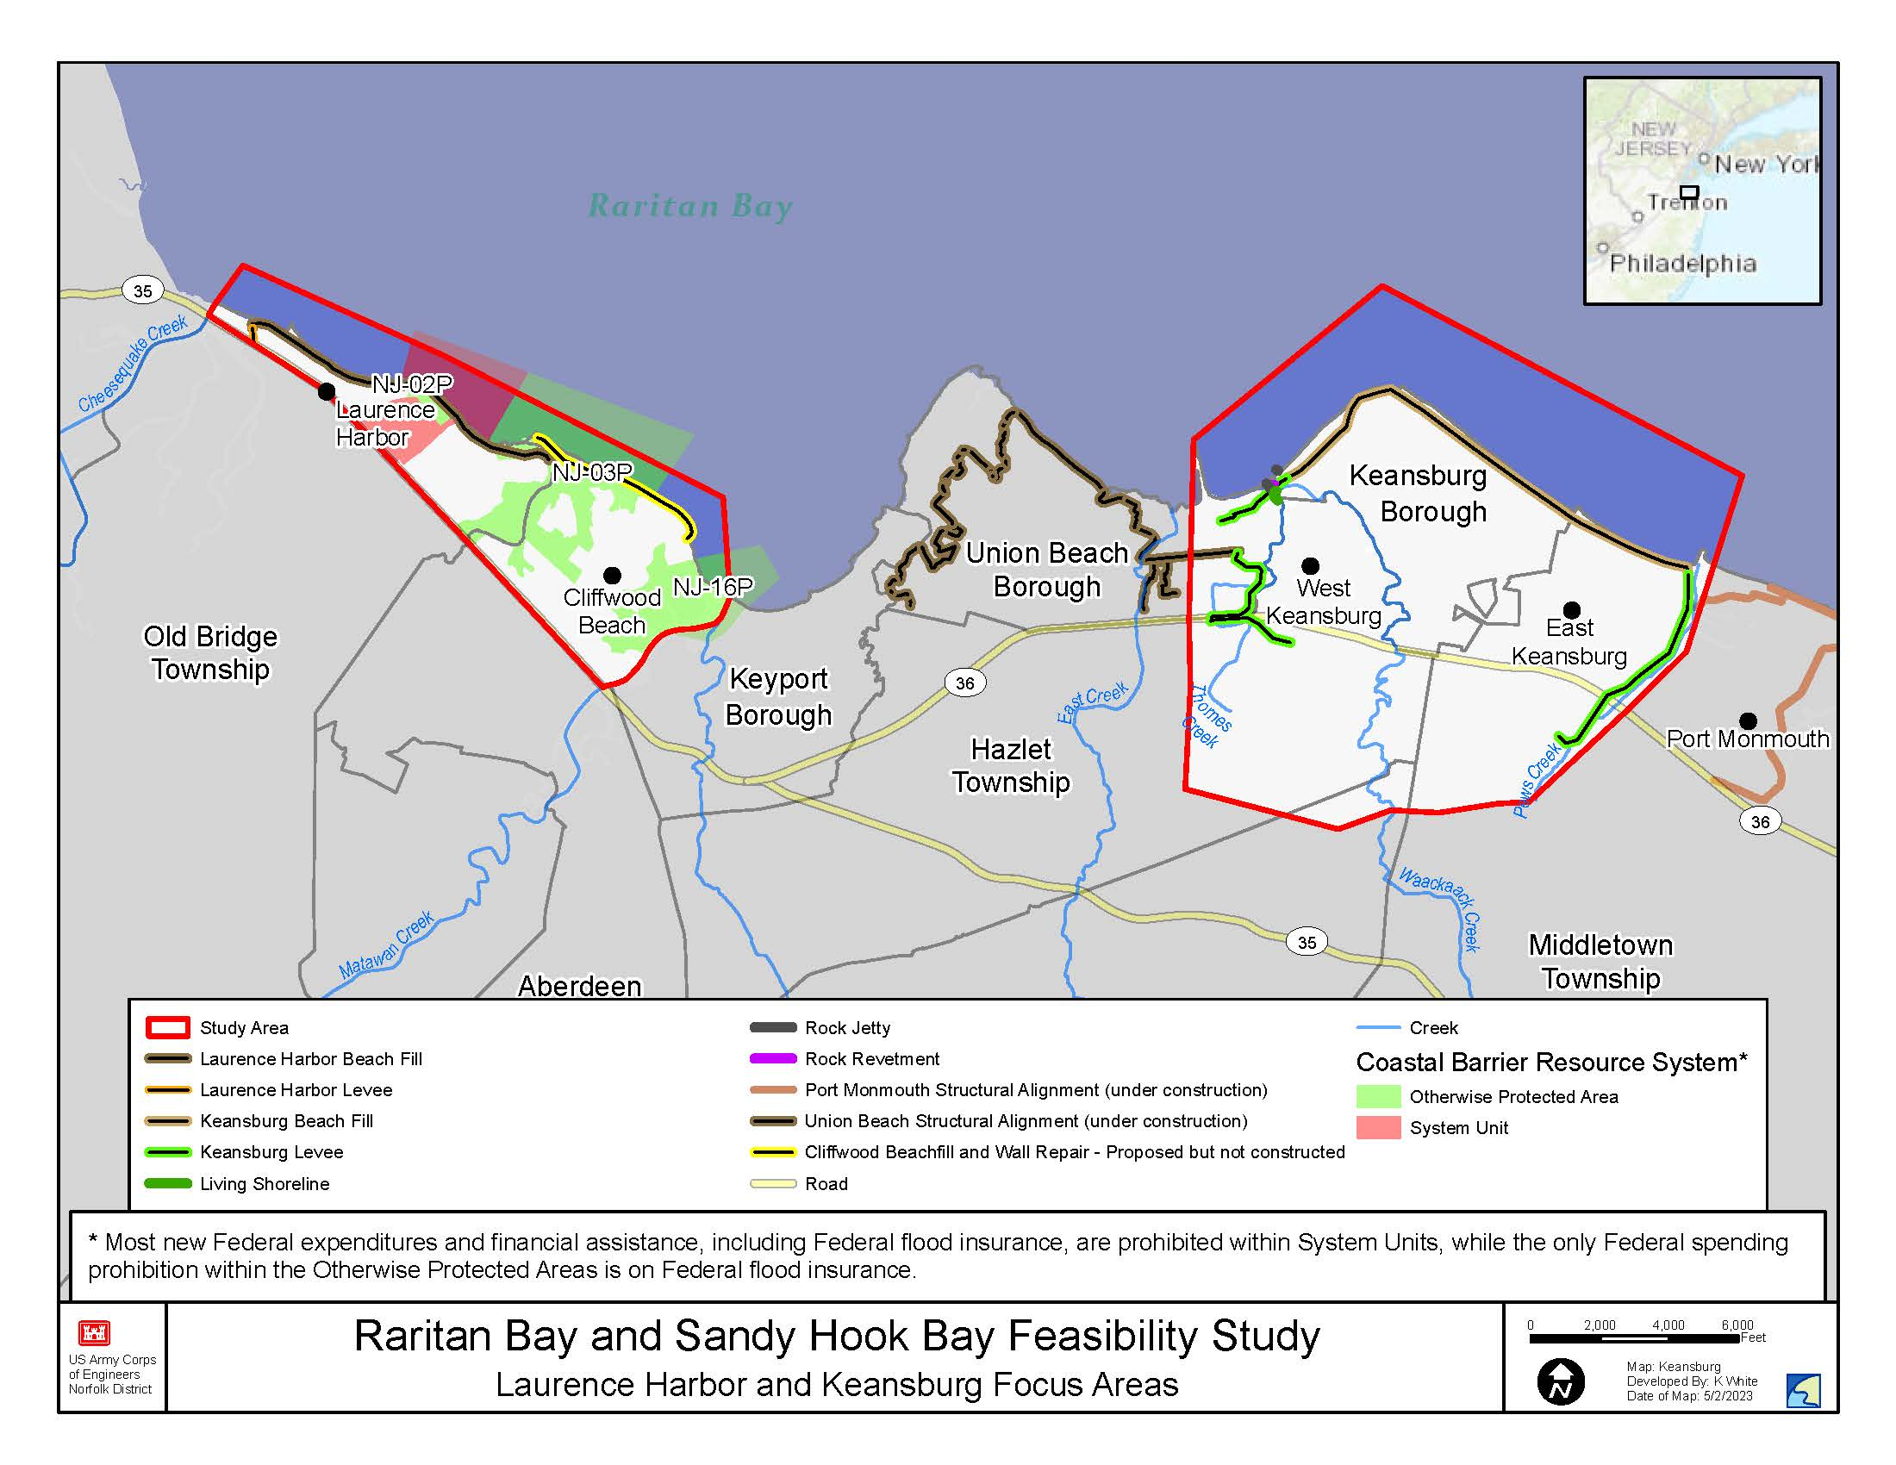
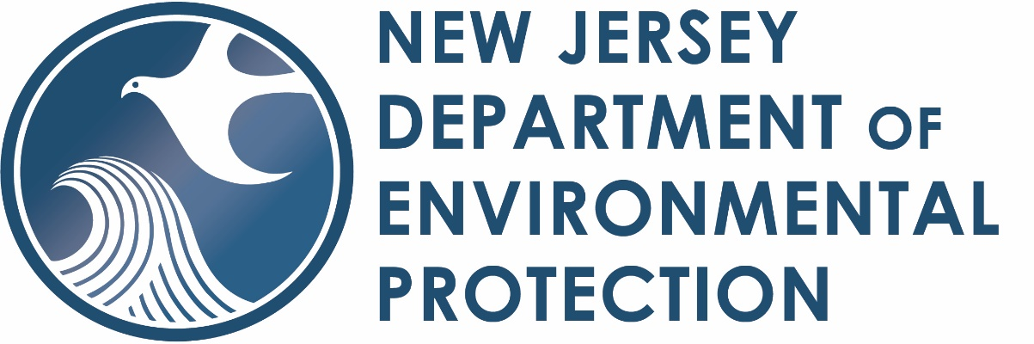
Project Authority
Section 216 of the River and Harbor and Flood Control Act of 1970 (PL 91-611).
The Flood Control Act of 12 October 1962 authorized the construction of the Federal project as a dual-purpose Beach Erosion Control and Hurricane Shore Protection Project in accordance with House Document No. 464, 86th Congress, Second session.
Disaster Relief Supplemental Appropriations Act, 2022 (Public Law 117-43).
Purpose and Need
The NJDEP has requested the
reevaluation of all the previously
authorized project areas,
constructed and unconstructed, citing
notable changes in storm impacts
since the original 1964 study was
completed.
The study area includes Keansburg, Middletown, Hazlet, Old Bridge, Cliffwood Beach and Laurence Harbor
Sponsor
Project website: https://www.nao.usace.army.mil/About/Projects/-Raritan-Bay-and-Sandy-Hook-Bay-CSRM-Study/
Notes:
In addition to looking at prior constructed features, as well as features planned but never constructed, the Corps our partner DEP can consider other actions to protect life and property from coastal storms. The study is not addressing any inland flooding, only flooding from coastal storms. Inland flooding is a local responsibility.

Slide 2
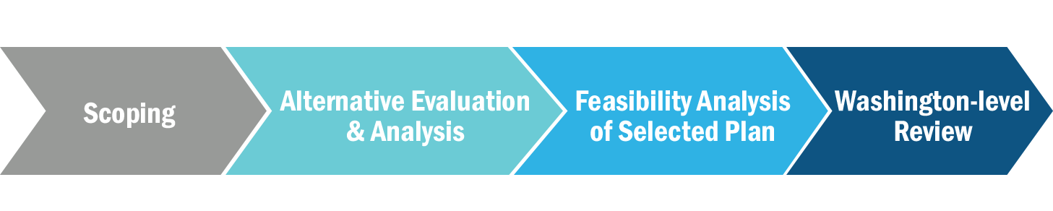



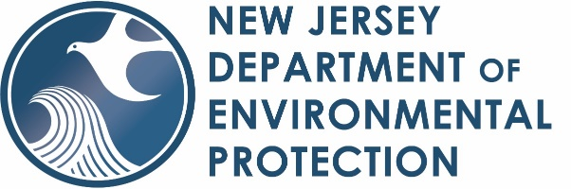
Process and Timeline
THE FEASIBILITY STUDY PROCESS:
THE CIVIL WORKS PROCESS:
Key Decision & Product Milestones
~3 months ~9 months ~6 months
~12 months
~6 months
Study Initiation Phase
We Are Here
Key
AMM
TSP
ADM
Decision Milestone
Product Milestone
Opportunities for Public Input
Draft Report Released for Public and Agency Review
Final Report Transmittal
Signed Chief’s Report
We Are Here
Feasibility Phase
Focus on scaling, or optimizing, the measures and features for the recommended plan
Focus on identifying and evaluating alternatives to identify a recommended plan for more detailed design
Pre-construction, Engineering, and Design (PED) Phase
Milestone | Date
Signing of Feasibility Cost Share Agreement (CW130) | 18 OCT 22
Alternatives Milestone (CW261) | 8 FEB 23
Tentatively Selected Plan Milestone (CW262) | 8 FEB 24
Draft Report Submittal to HQ (CW150) | 10 APR 24
Public Release of Draft (CW250) | 10 APR 24
Agency Decision Milestone (CW263) | 18 FEB 25
Submit Final Report Package to Vertical Team (CW160) | 18 AUG 25
Signed Chief’s Report (CW270) | 18 FEB 26
Construction Phase
Notes:
We are early in the study and the public can provide us with comments at any time. It typically takes three years for a study of this size and complexity to be completed, sometimes longer. These studies have to consider present problems and plan to maintain the benefits of storm risk reduction of any construction for the next 50 years. This will require us to plan ahead and take into account during construction future sea level rise and higher and stronger storm surges due to climate change. The stars show specific study times where the USACE and NJDEP will be seeking public input, but we will accept comments from the public at any time during the study.

Slide 3
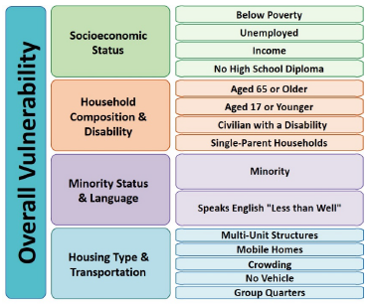
Environmental Justice Outreach
Environmental Justice is the fair treatment and meaningful involvement of all people regardless of race, color, national origin or income regarding project planning and proposed construction.
No group should bear a disproportionate burden of environmental harms and risks.
The US Army Corps of Engineers considers Environmental Justice in all phases of project planning and decision-making – everyone in the project area will be treated equally and have opportunities to have your voice heard.
Environmental Justice Considerations
Thank you all for coming to this meeting!
Notes:
We coordinate with all communities in the project area during the planning phase. The USACE has new guidance that requires us to ensure that all communities have been coordinated with equally.

Slide 4

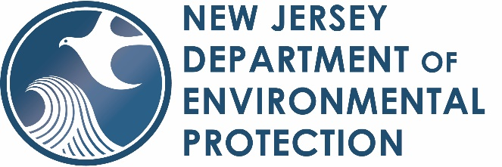

PROBLEMS
OPPORTUNITIES
OBJECTIVES
CONSTRAINTS
Critical infrastructure is at risk to the effects of coastal storms.
Critical transportation and evacuation routes are at risk to the effects of coastal storms.
Structures (commercial and residential), are damaged by coastal storms.
Utilities including water, wastewater, electricity, phone, etc. are at risk to the effects of coastal storms.
Reduce economic impacts from coastal storms and coastal flooding.
Reduce the risks to human life, health, and safety.
Improve the resilience of the Towns of Keansburg, Cliffwood Beach section of Aberdeen Twp., Laurence Harbor section of Old Bridge Twp., North Middletown Section of Middletown Twp., and Hazlet to the impacts of coastal storms and flooding.
Utilize Natural and Nature-Based Features (NNBFs) and/or restoration of the natural coastal system of defenses to reduce impacts from coastal storms.
Improve floodplain management.
Improve recreation opportunities.
Manage economic impacts from coastal storms and coastal flooding to development within the Study Area for the 50-year analysis period (2036-2085).
Manage the coastal storm risk to human life, health, and safety to the population in the Study Area over the 50-year analysis period (2036-2085).
Minimize adverse effects to sensitive environmental and cultural resources.
Minimize adverse effects to disadvantaged environmental justice communities.
Do not create or exacerbate coastal storm impacts and/or flooding within and around the study area, including military installations in the vicinity.
Do not create or exacerbate risk to human life, health, or safety.
Do not re-suspend or increase levels of contaminants present in some structures and sediments near the project area. Cannot work in area where cleanup is being done by EPA while work is ongoing.
Notes:
We hope to manage and reduce coastal storm impacts to the project area. We cannot eliminate this risk, as there is always a chance for a storm that exceeds design parameters. We base our plans to protect the area by considering the current and future strength of coastal storms and associated flooding. We consider sea level rise that has occurred and is projected to occur over the next 50 years.
Natural and Nature-Based features (NNBF) could include wider beaches, higher dunes, restored wetlands (which also reduce wave energy and store flood water, helping prevent flooding of urban areas), and even oyster reefs. There used to be extensive oyster reefs in the area, but they’ve been gone for more than a century. We will consider restoring oyster reefs where possible to help reduce storm surge.
The corps cannot work in the EPA superfund site, as that is being managed by others and a clean up is underway. Our study will consider any movements of contamination outside the site that might happen due to project construction.
Improved recreation opportunities could include better recreational fishing and bird watching, among others.

Slide 5
Study Considerations
Sea Level Change
Actions by Other Agencies/Organizations
Recreational Navigation
Existing/Future Environmental Conditions
Flood Pathways
Evacuation Corridors
Port Monmouth and Union Beach Projects, NYNJHATS
Protected Resources
Environmental Justice Communities
NJDEP and Municipality Projects
CBRS and HTRW Areas
Notes:
The Port Monmouth and Union Beach projects are in construction and are directly adjacent to the Keansburg portion of the study area where the existing project is. The study area is also located within the NYNJ Harbor and Tributaries Study area, but the TSP for that study does not include any measures in our study area. The PDT has been coordinating with the NY and NJ Harbor and Tributaries Focus Area Feasbility Study (NYNJHATS) team and the New York District Army Corps of Engineers (NAN) to ensure that there is no redundancy between these two studies and that they compliment each other for maximum storm reduction benefits in our project areas.
There are Coastal Barrier Resources Act (CBRS) units and otherwise protected areas in the Laurence Harbor and Cliffwoood Beach portion of the study area. USFWS can sometimes restrict development and construction in CBRS areas. There is also a Hazardous, Toxic and Radioactive Waste (HTRW) (designated a Superfund site that requires remediation) that is located in the study area. We can do work in the CBRS areas but not within the Superfund site.

Slide 6
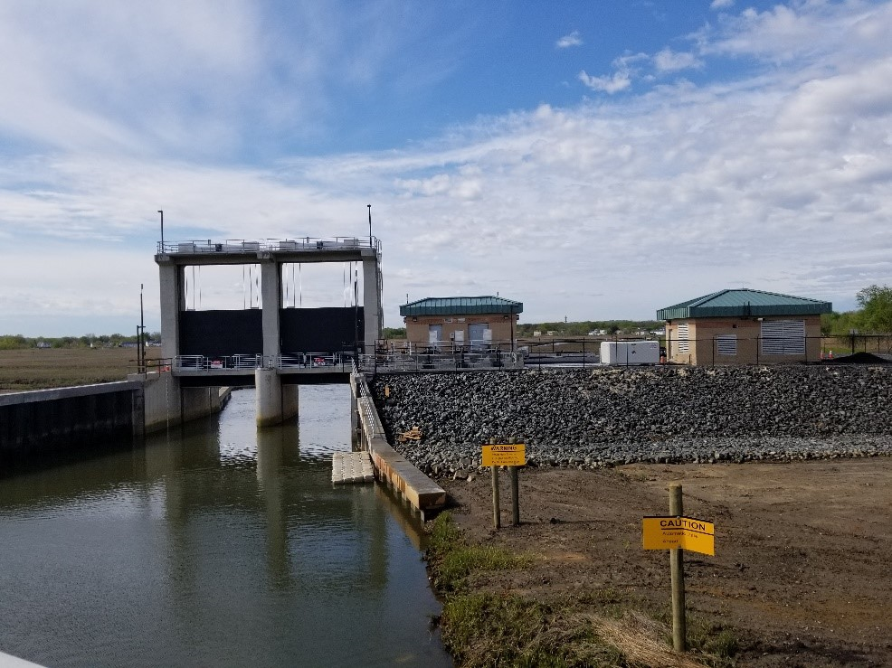
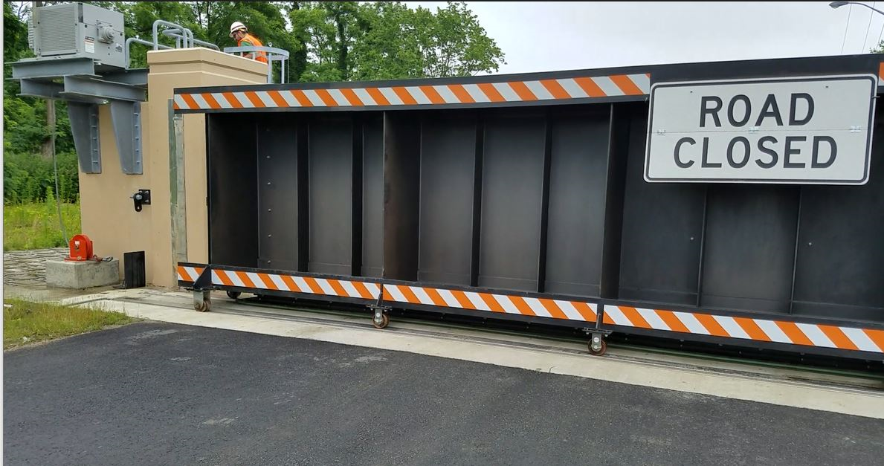
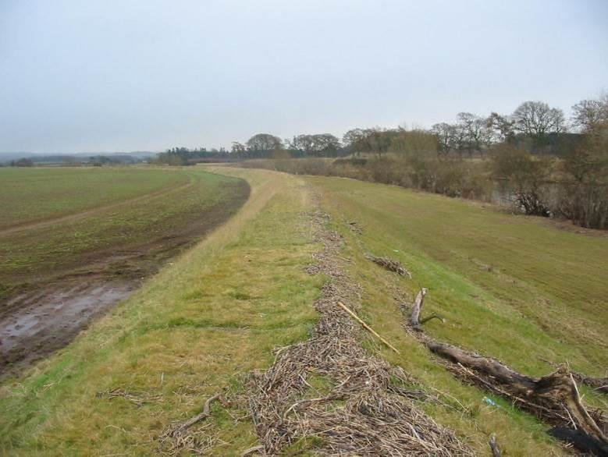
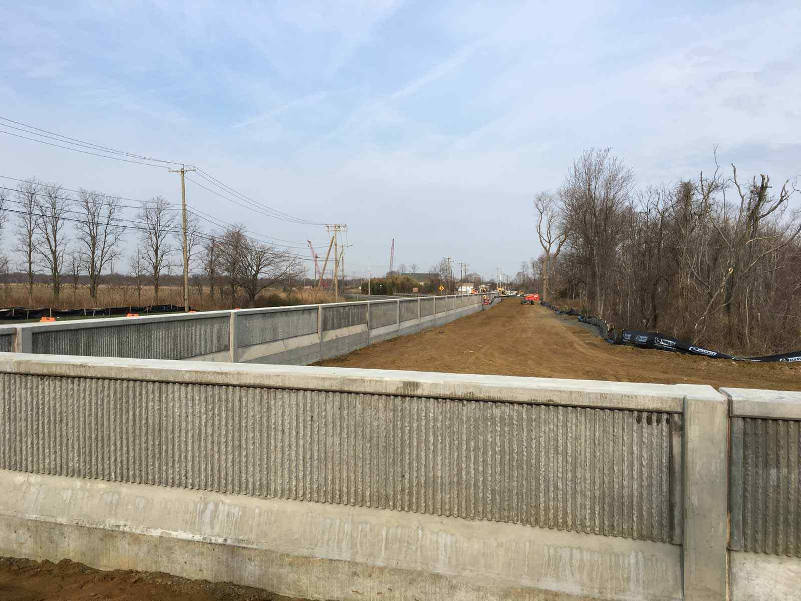

Potential Structural Measures
Road Closure Gates
Levees
Storm Surge Barriers/Tide Gates
Floodwalls
Notes:
Please note that we are not considering a tide gate/surge barrier across Raritan Bay, Sandy Hook Bay or across the mouth of Lower New York Bay. We are considering these features for some of the tidal creeks flowing into the Bay from the project area’s watershed.

Slide 7
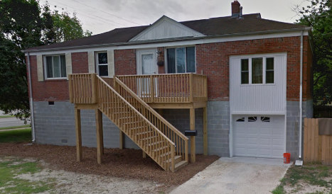
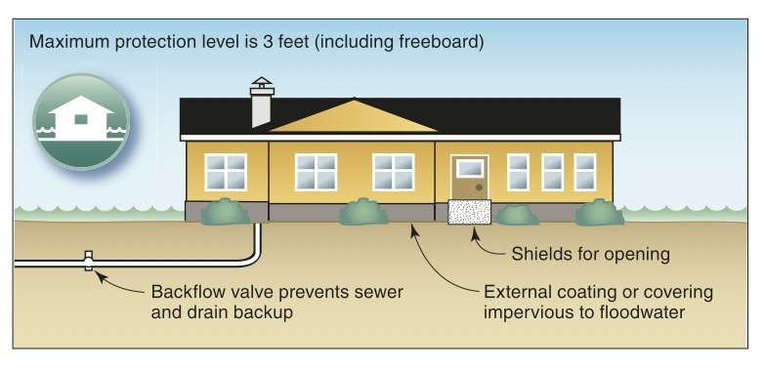
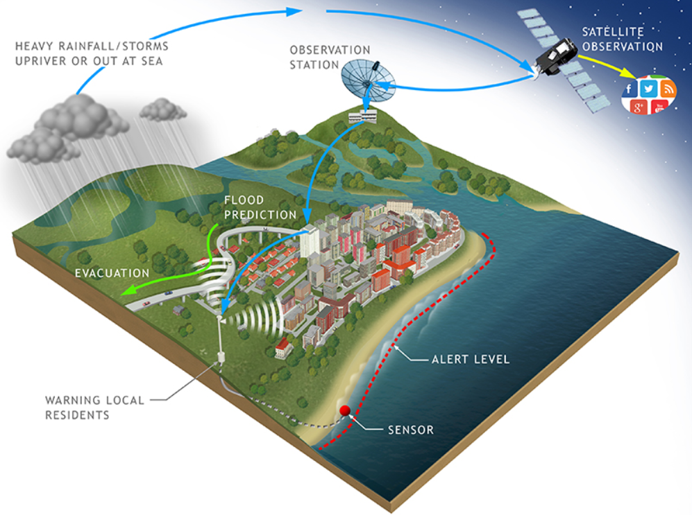
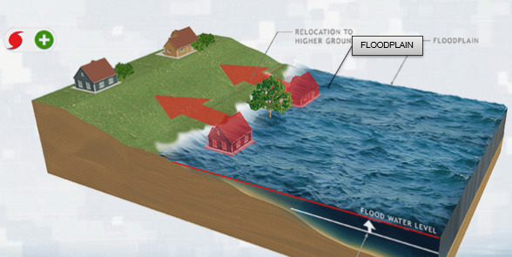
Potential Nonstructural Measures
Floodproofing – dry/wet
Elevation
Acquisition/Relocation
Warning Systems
Notes:
Dry floodproofing means that the building is designed to remain dry on all floors during a flood, wet-proofing means that the first/lower floor can flood but this floor would not contain features that could be damaged by flood waters. These are typically enclosed areas below elevated buildings, basements, crawlspaces or garages – not living space. Acquisition and relocation are typically done only as a last resort. Where relocations are done, the land is allowed to return to its natural state and no new development in the area is permitted.

Slide 8
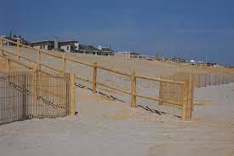
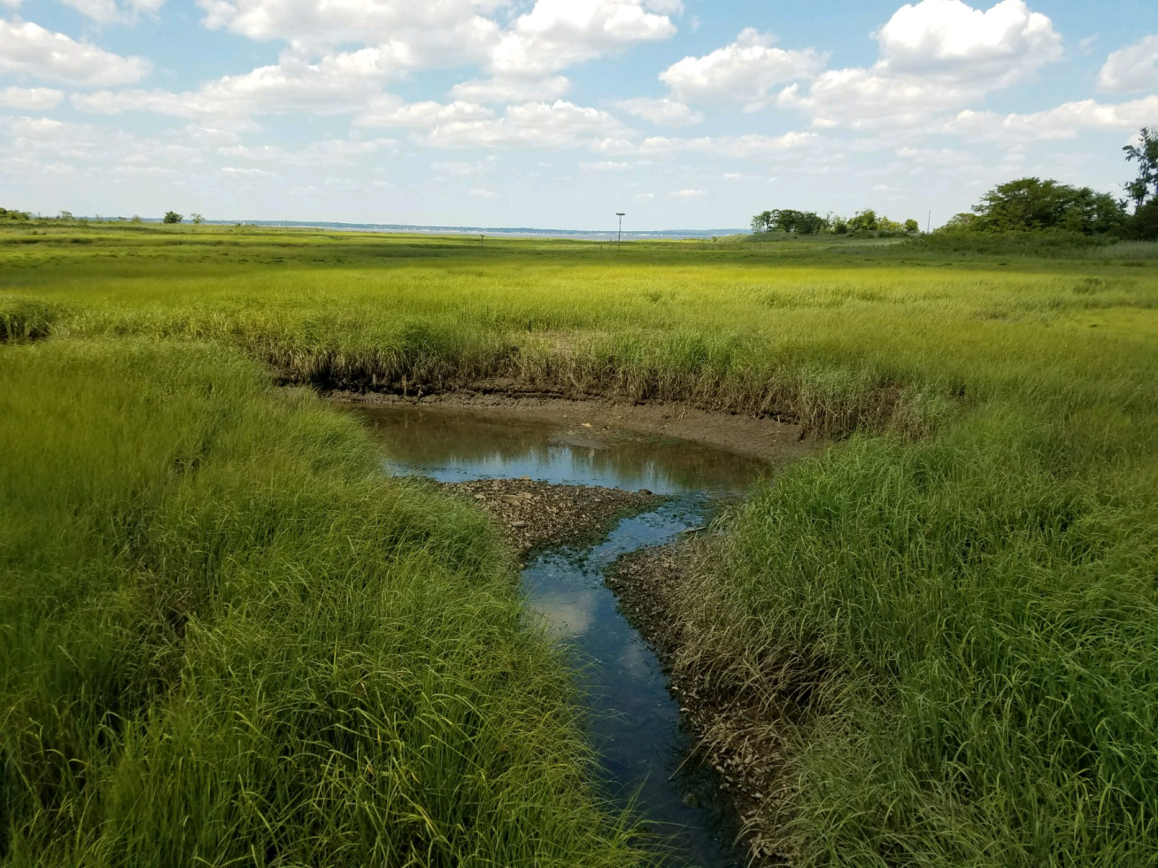
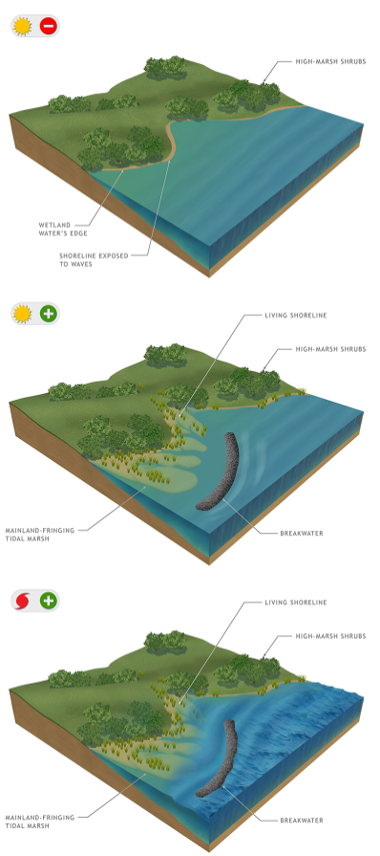
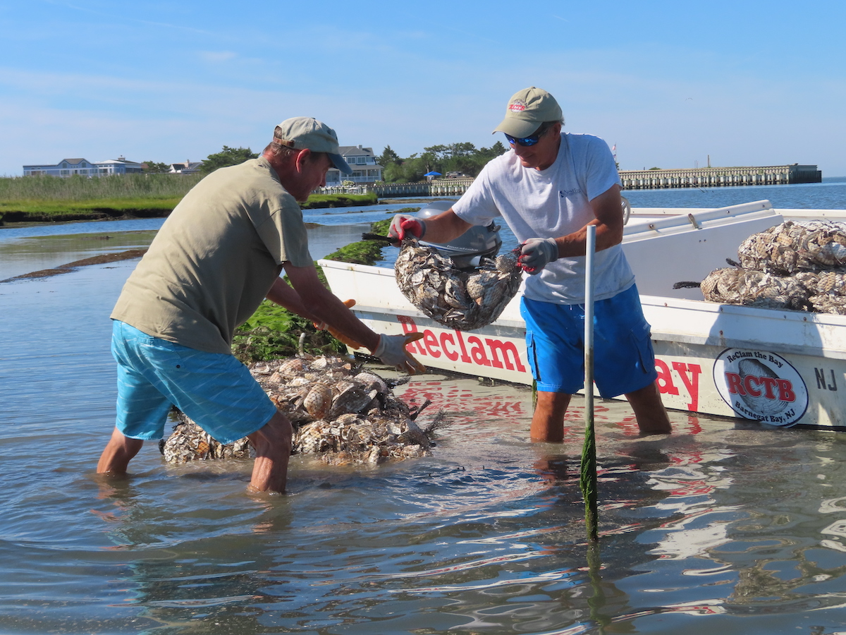
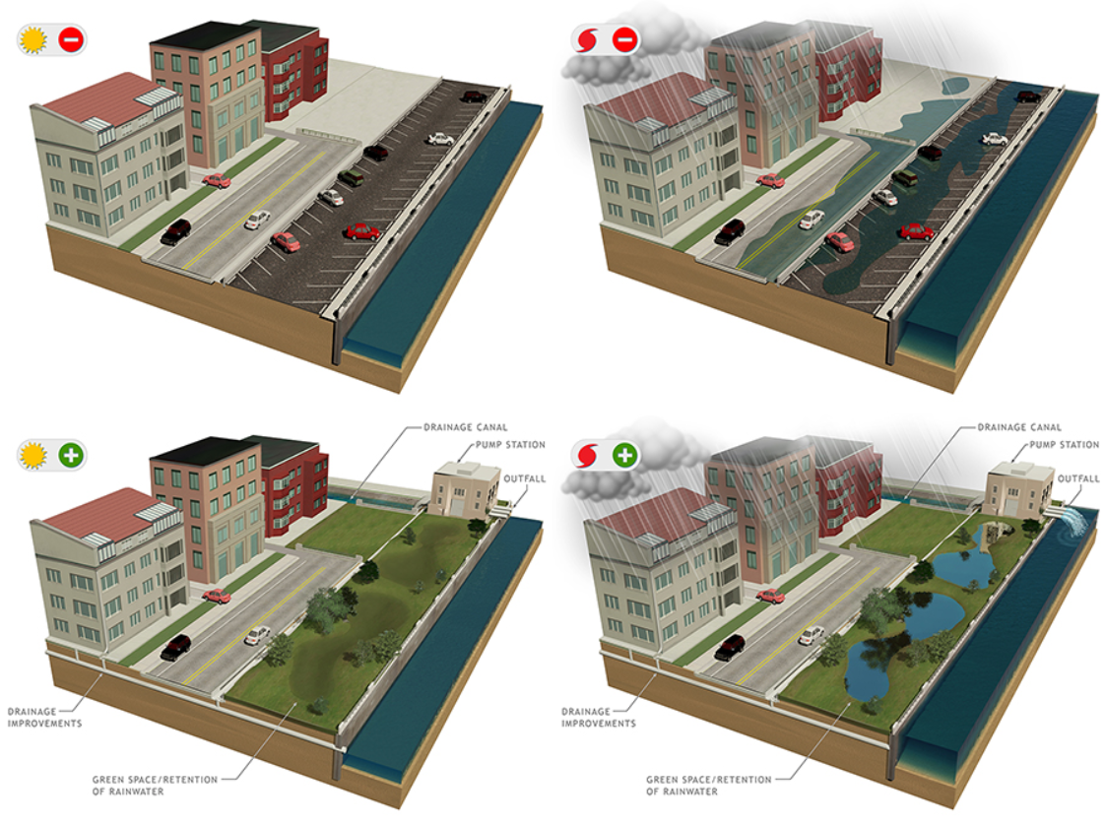

Potential Measures: Natural and Nature-Based Features
Beachfill/Dune Enhancement/Breakwaters
Tidal Wetland Creation/Restoration
Oyster Reef Structures
Drainage Improvements/Water Storage Features
Living Shorelines
Notes:
Natural and Nature-Based Features (NNBF) is using restored natural habitat (mother nature) to help reduce storm surge and/or coastal flooding. Vegetated habitat such as wetlands and forests can reduce incoming wave height and energy by absorbing some of it as the waves crash against and over the vegetation. Vegetated habitats can also store floodwater, reducing flooding during a coastal storm. Oyster reefs directly reduce incoming storm surge and wave energy as the waves crash into and flow over the reefs. Wider beaches act to absorb incoming storm surge waves, as do dunes. Natural water storage features are typically wetlands with lower areas that can retain water as a temporary pond during a coastal storm event. Drainage improvements would typically be restoring old tidal creek channels that were filled in the past and removing obstacles such as construction debris from stream beds that restrict flow.

Slide 9
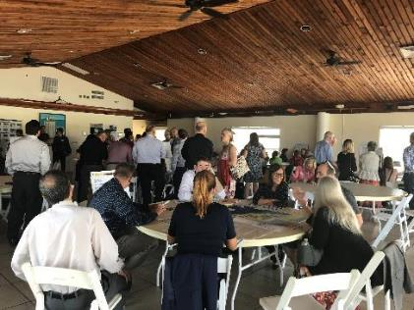
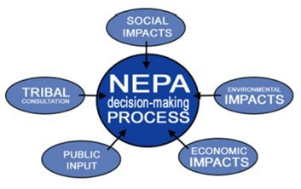
NEPA and Environmental Compliance
National Environmental Policy Act (NEPA)
What type of NEPA document will be prepared?
What environmental topics may be considered?
How can I provide comments?
One of the nation’s oldest environmental laws.
Requires federal agencies to consider and disclose the environmental effects of their proposed actions and consider public input during the NEPA process.
Encourages federal agencies to make environmentally responsible decisions.
The U.S. Army Corps of Engineers (USACE) intends to prepare either an Environmental Assessment (EA) or an Environmental Impact Statement (EIS).
An EA would be prepared if there are no anticipated significant impacts. An EIS would be prepared if there are anticipated significant impacts.
If preparation of an EIS is needed, a Notice of Intent would be published online in the Federal Register. We assume at this time an EA will be required.
The NEPA documentation will be integrated into the feasibility study report.
Air Quality
Climate Change/ Sea Level Rise
Cultural and Historic Resources
Demographics
Socioeconomics and Environmental Justice
Wetlands
Fish and Wildlife Resources
Commercial and Recreational Fisheries
Hazardous, toxic, and radioactive materials
Hydrology
Land Use
Navigation
Noise and Vibration
Recreation
Protected Species
Traffic
Water Quality
Floodplains
You may fill out a written
comment form at this meeting
and place it in the comment box.
You may e-mail or mail
Comments to:
Dave Schulte
U.S Army Corps of Engineers
Norfolk District
Planning and Policy Branch
803 Front Street
Norfolk, VA 23510
You may fill out a written comment form at this meeting and place it in the comment box.
Email: CWS1@usace.army.mil
Please submit scoping comments in writing at the hearing, or via mail or email by June 23, 2023.
For questions, please contact:
757-201-7007
What is
“Scoping” is the step in the NEPA process when the public is invited to participate in identifying issues, alternatives, and potentially significant effects to be considered in the analysis. This helps the USACE identify and eliminate from detailed study issues that are not significant or that have been covered by prior environmental review.
“scoping”?
Notes:
Please note that anyone can send in comments during any time during the study, though NEPA-related comments are typically accepted during a 30 or 45 day period.

