Slide 1
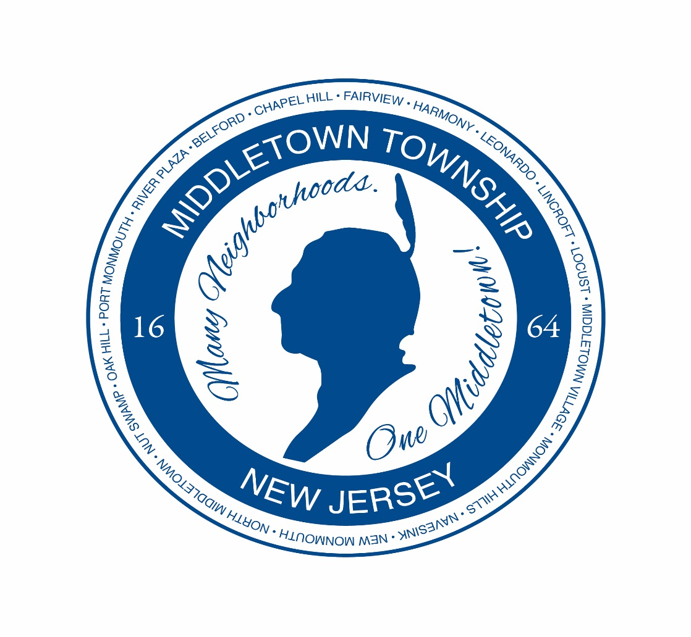
Middletown Land Development Forum
Mayor Gerard P. Scharfenberger, Ph.D.
Anthony P. Mercantante, P.P. AICP
July 26, 2017
Middletown Arts Center

Slide 2
Most Frequently Asked Questions About Development
One of the most important issues facing towns throughout New Jersey is how to prevent overdevelopment while encouraging sensible growth.

Slide 3
How could Middletown “allow” a particular development to happen?

Slide 4
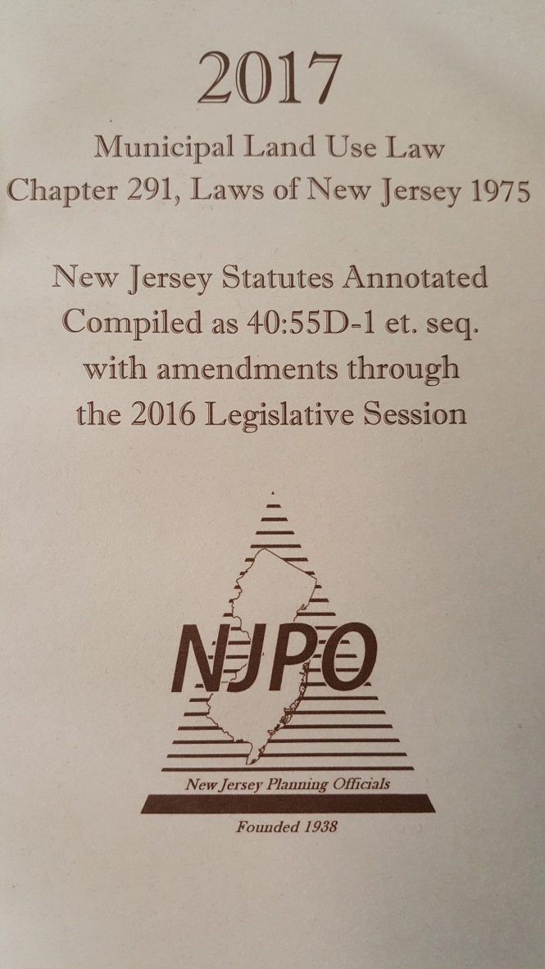
Statutory Requirements

Slide 5
How Does Development Work?
Municipal Land Use Law
Township Master Plan
Township Zoning Ordinances
Planning and Zoning Boards review applications for consistency with the Master Plan and Zoning Ordinances, all decisions must be based on evidence and testimony presented at an impartial public hearing and the facts of the case.

Slide 6
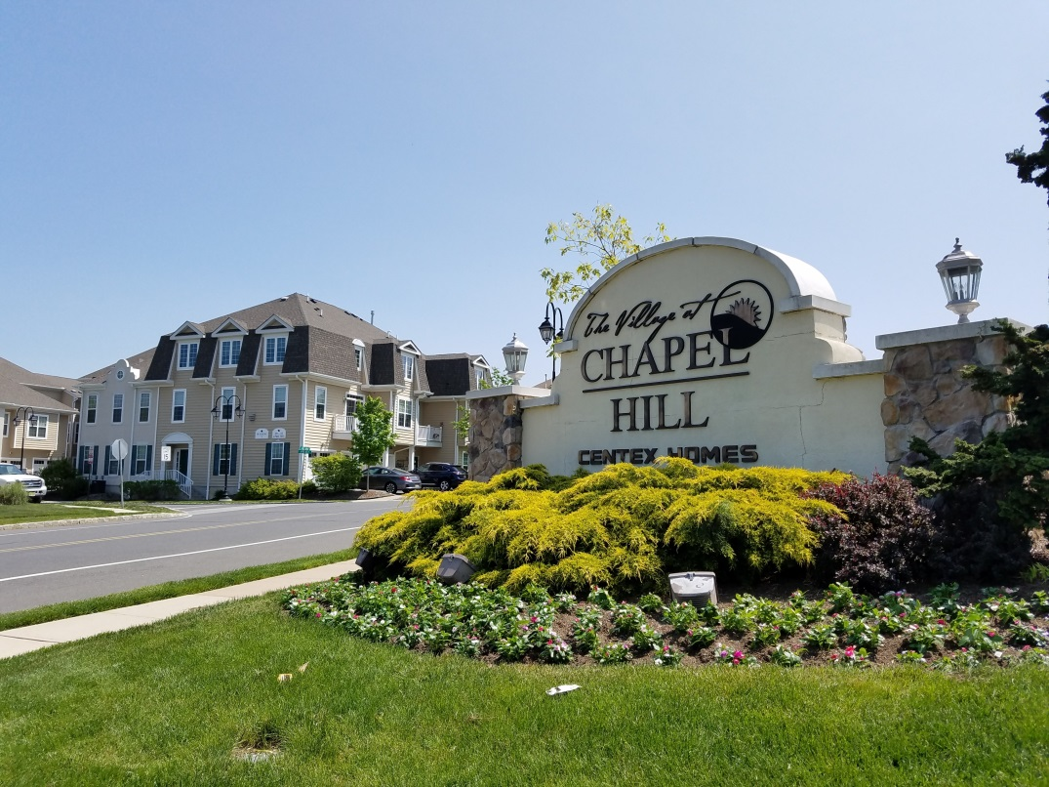
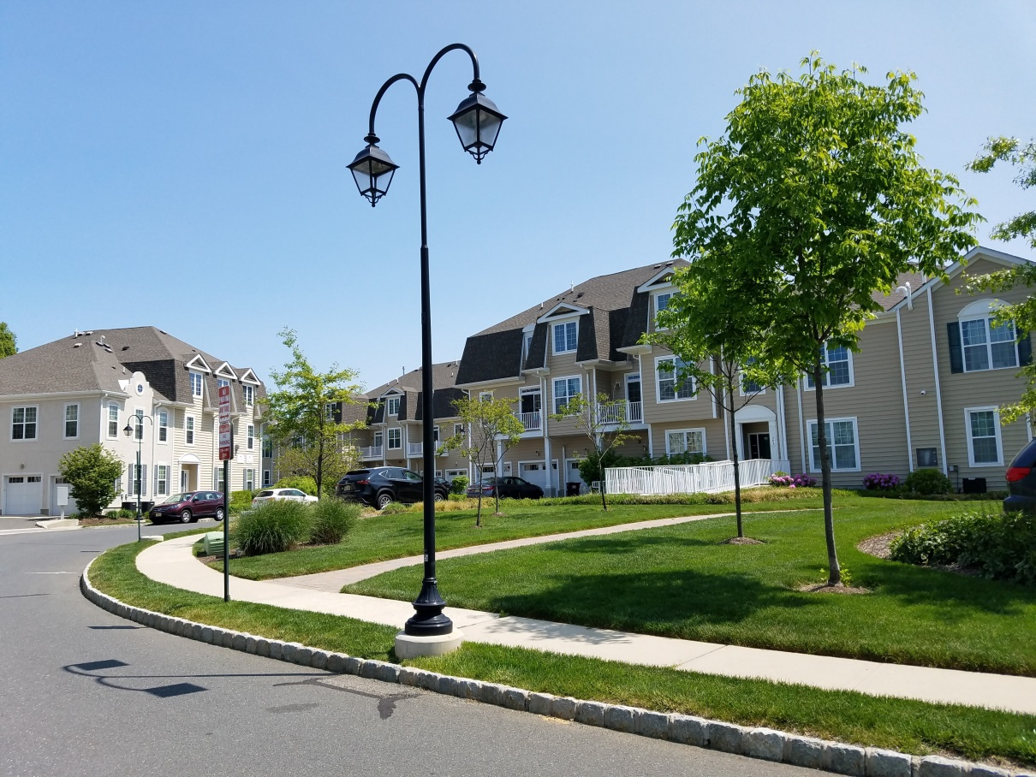
The Village
at
Chapel Hill

Slide 7
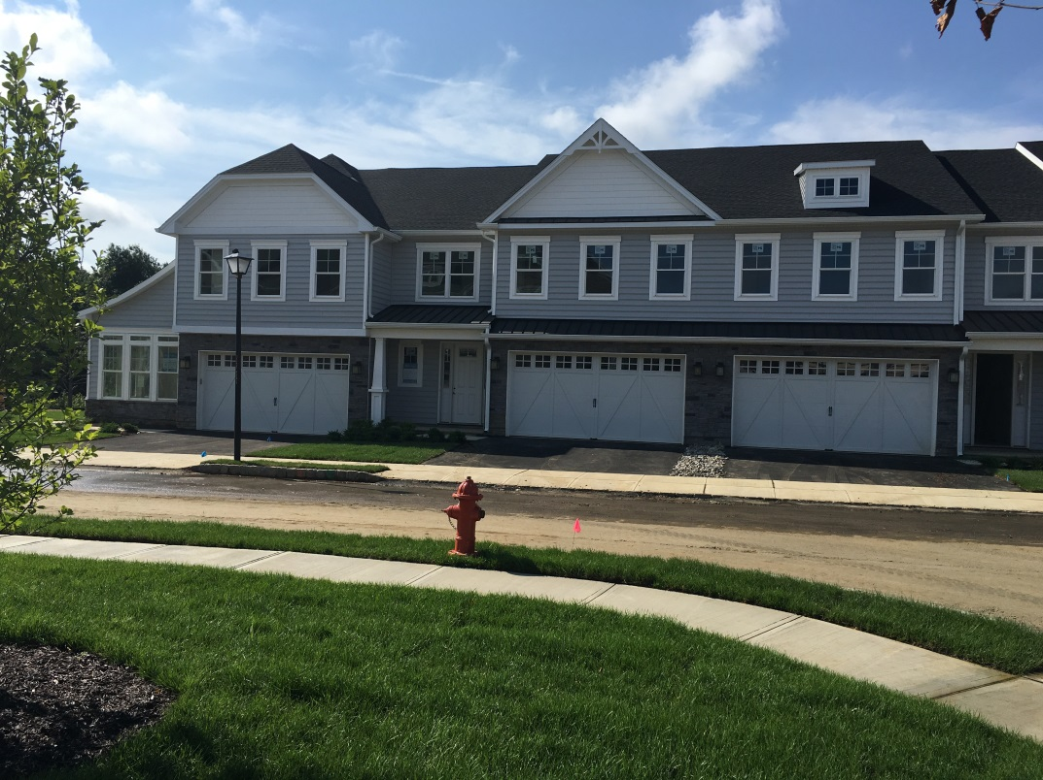
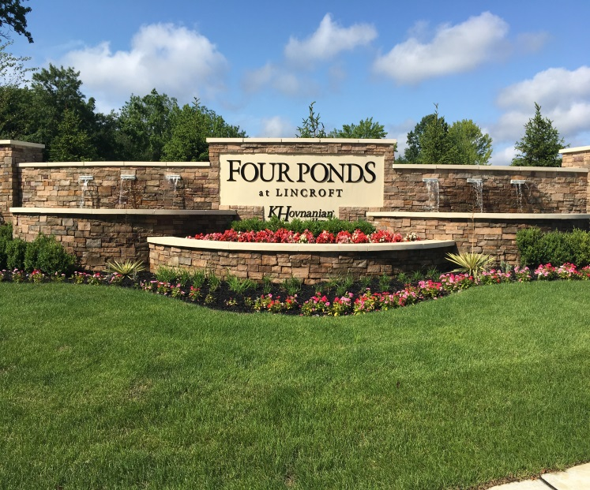
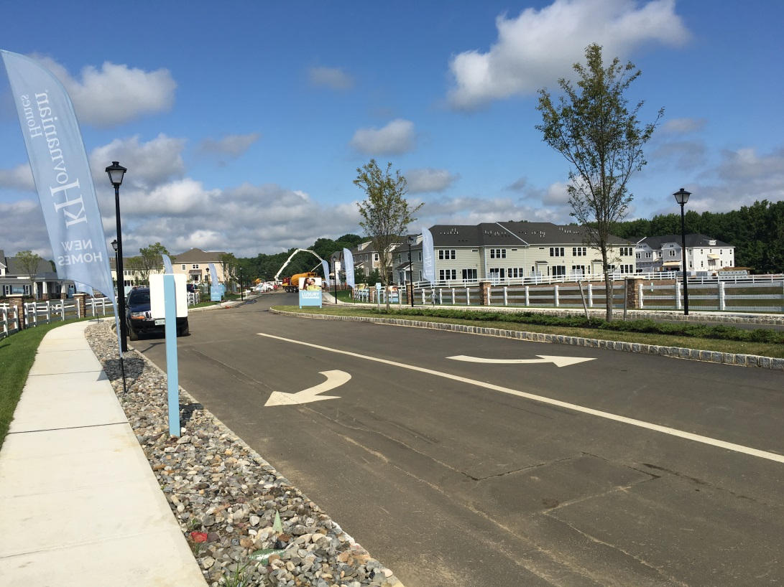
Avaya – Four Ponds Site

Slide 8
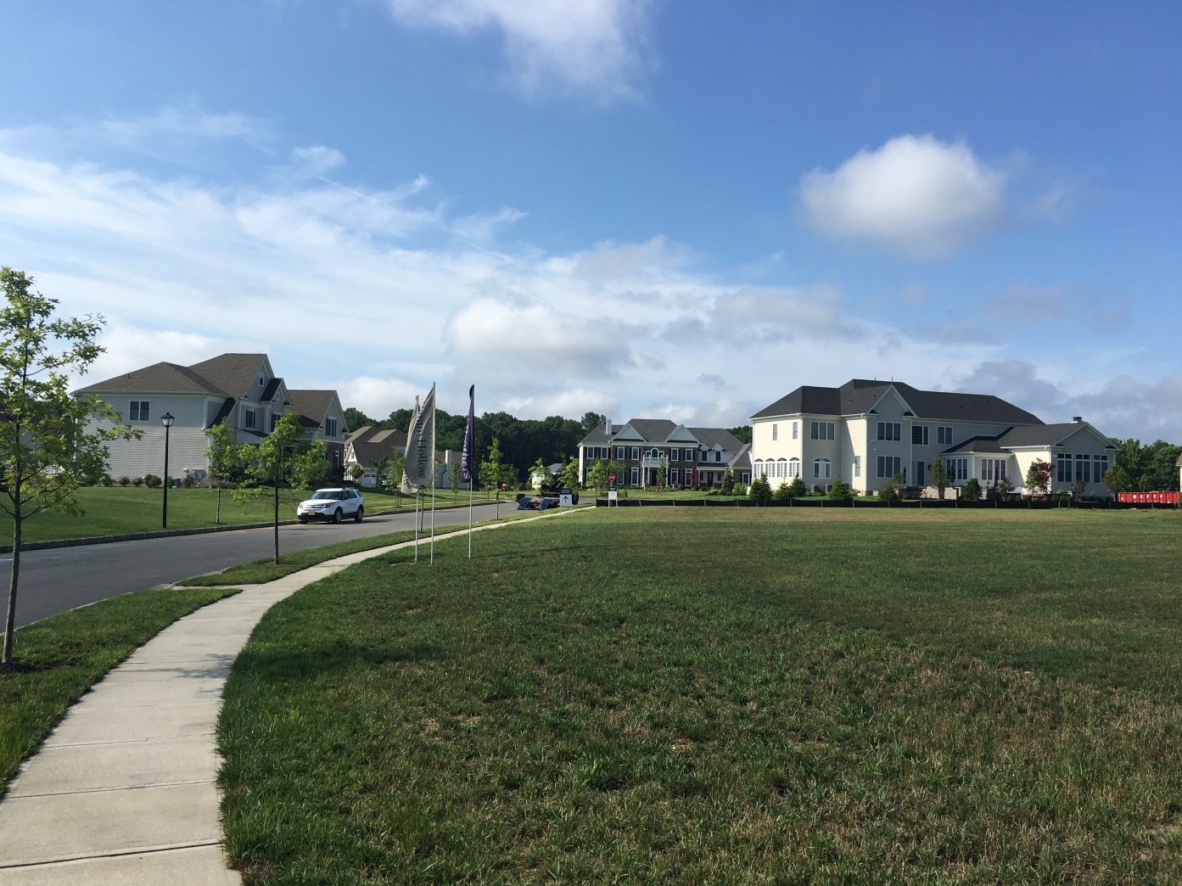
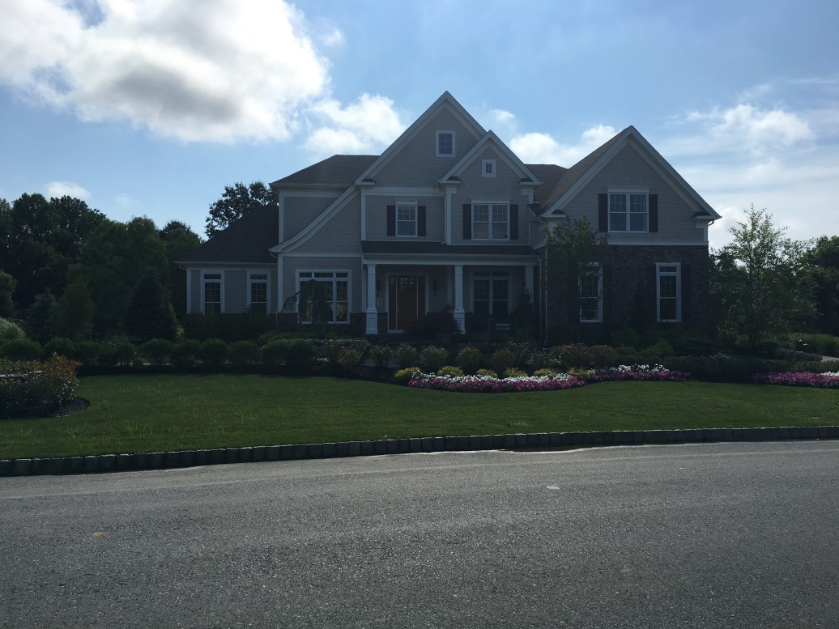
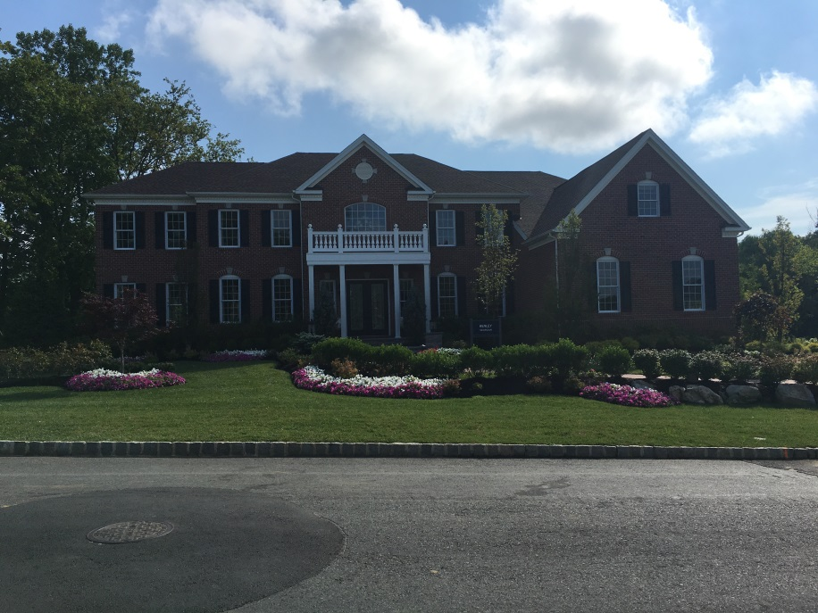
Bamm Hollow Estates

Slide 9
Why doesn’t Middletown prohibit the building of new office buildings or retail space until all existing vacant spaces are filled?

Slide 10
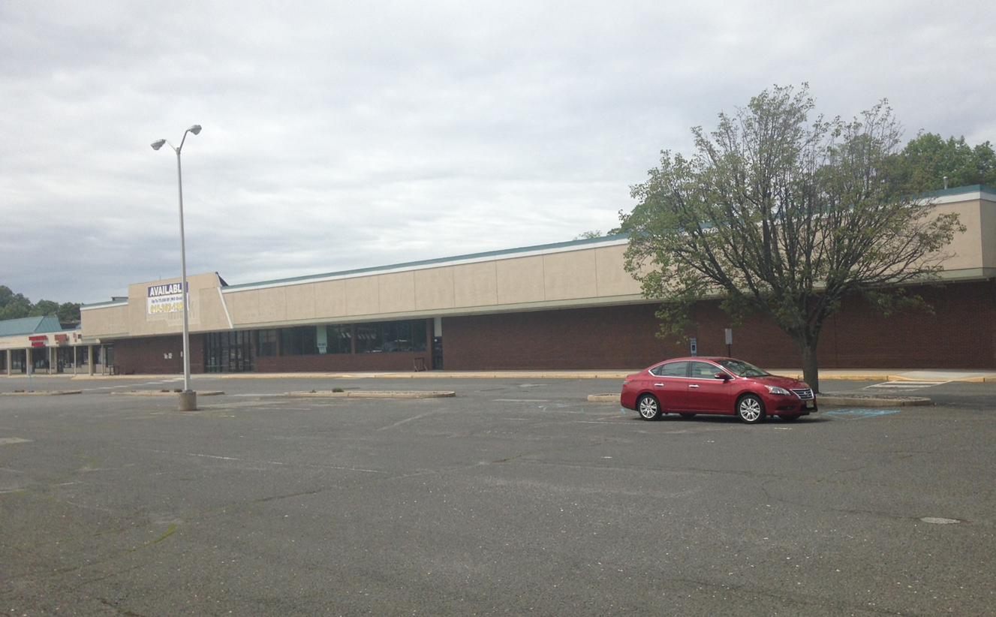
Highway 35 – Pathmark Site Before

Slide 11
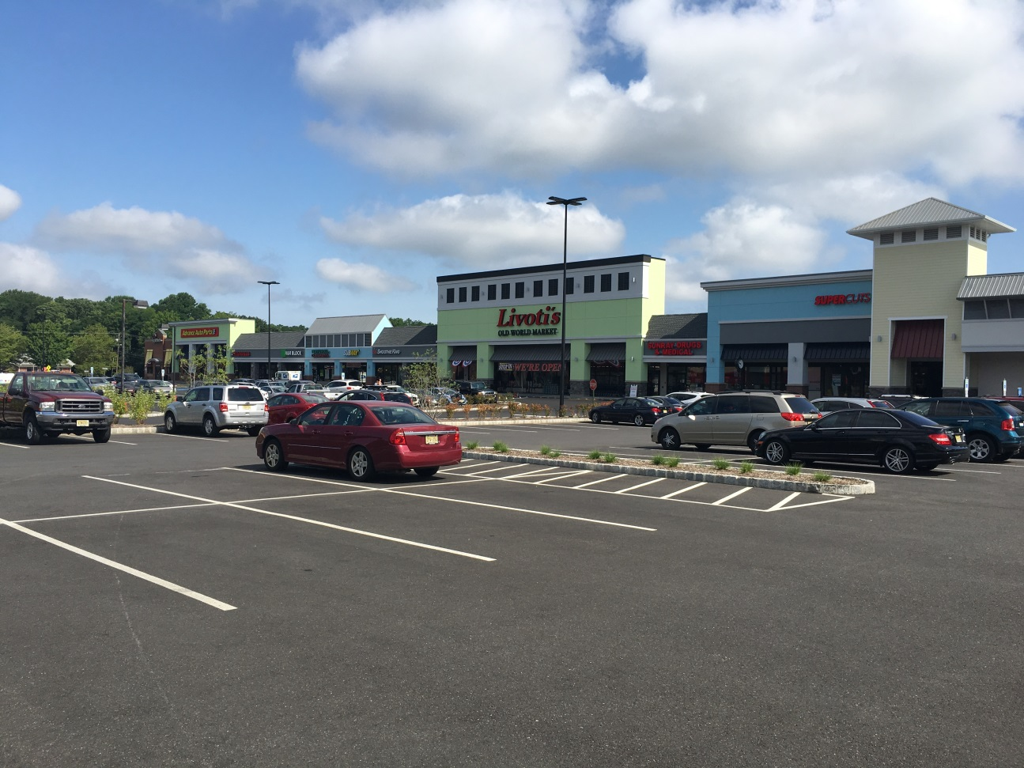
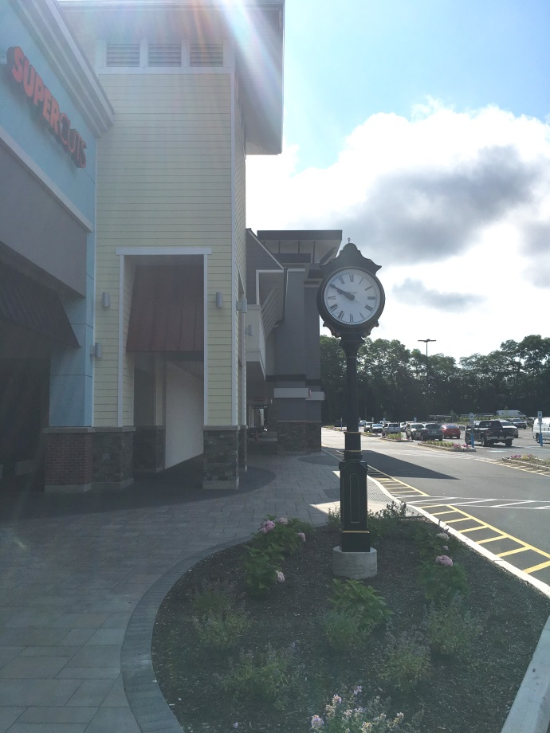
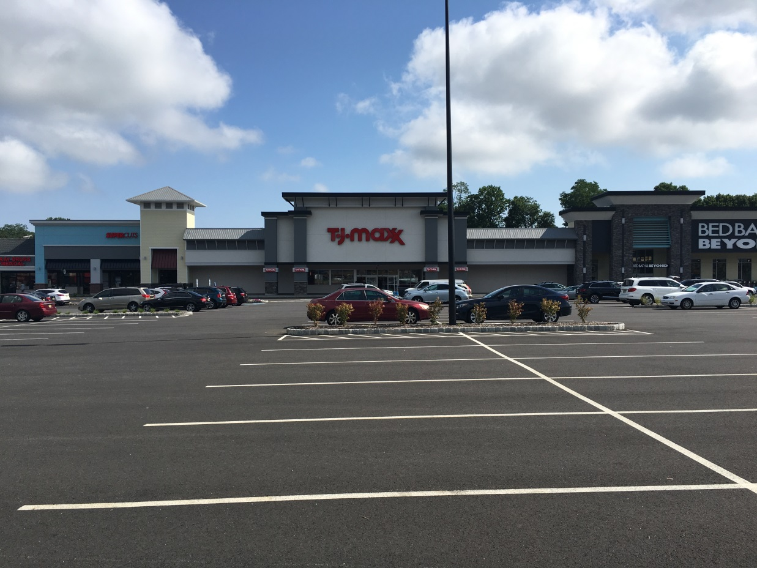
Pathmark Site-
After

Slide 12
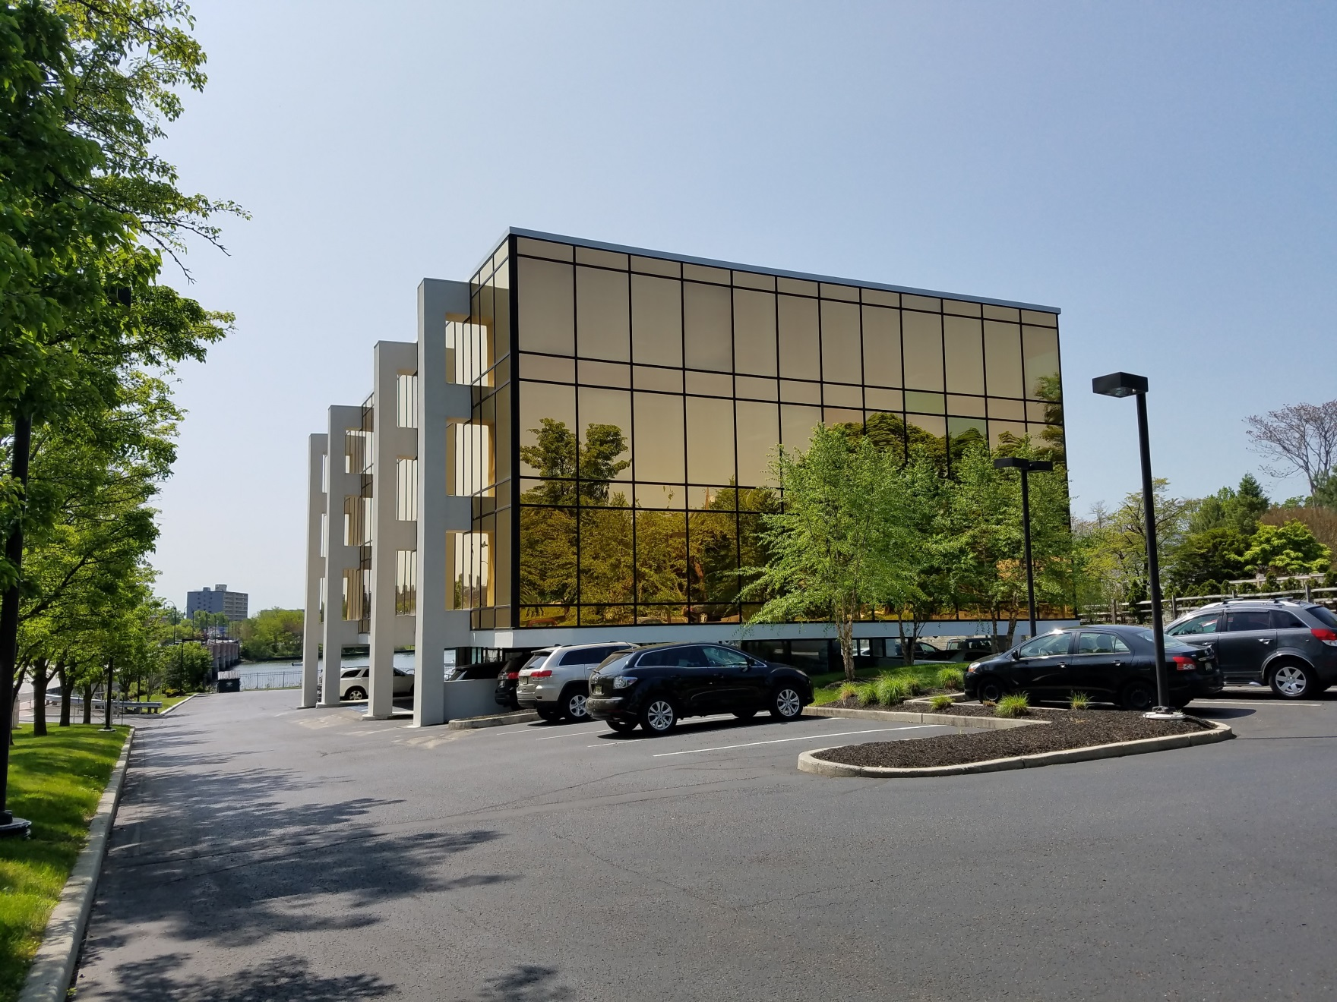
Riverview Plaza – Route 35

Slide 13
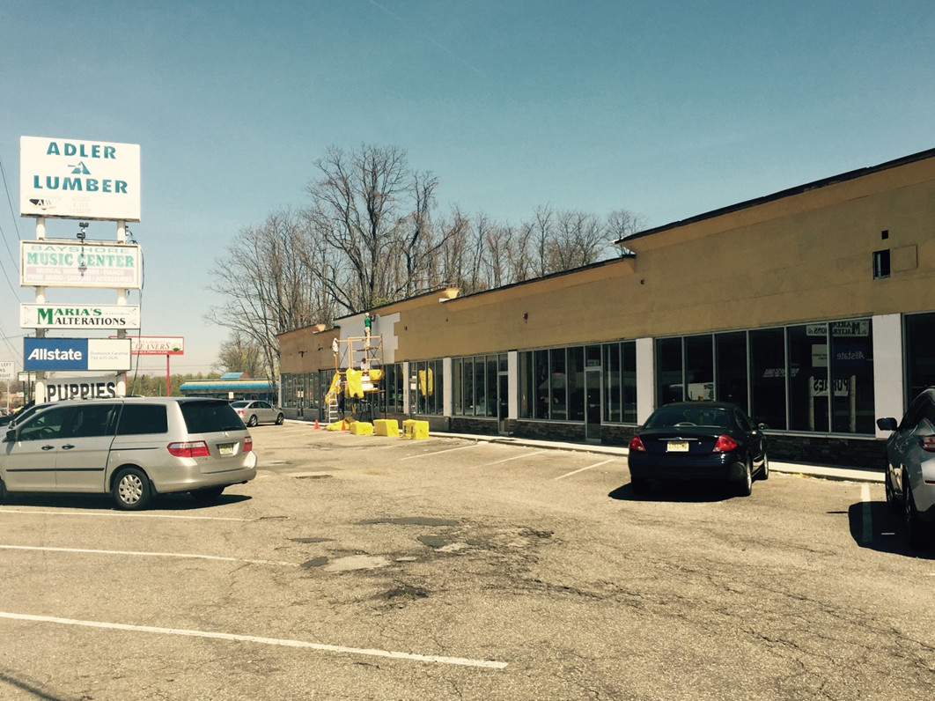
Adler Lumber site – before façade improvements

Slide 14
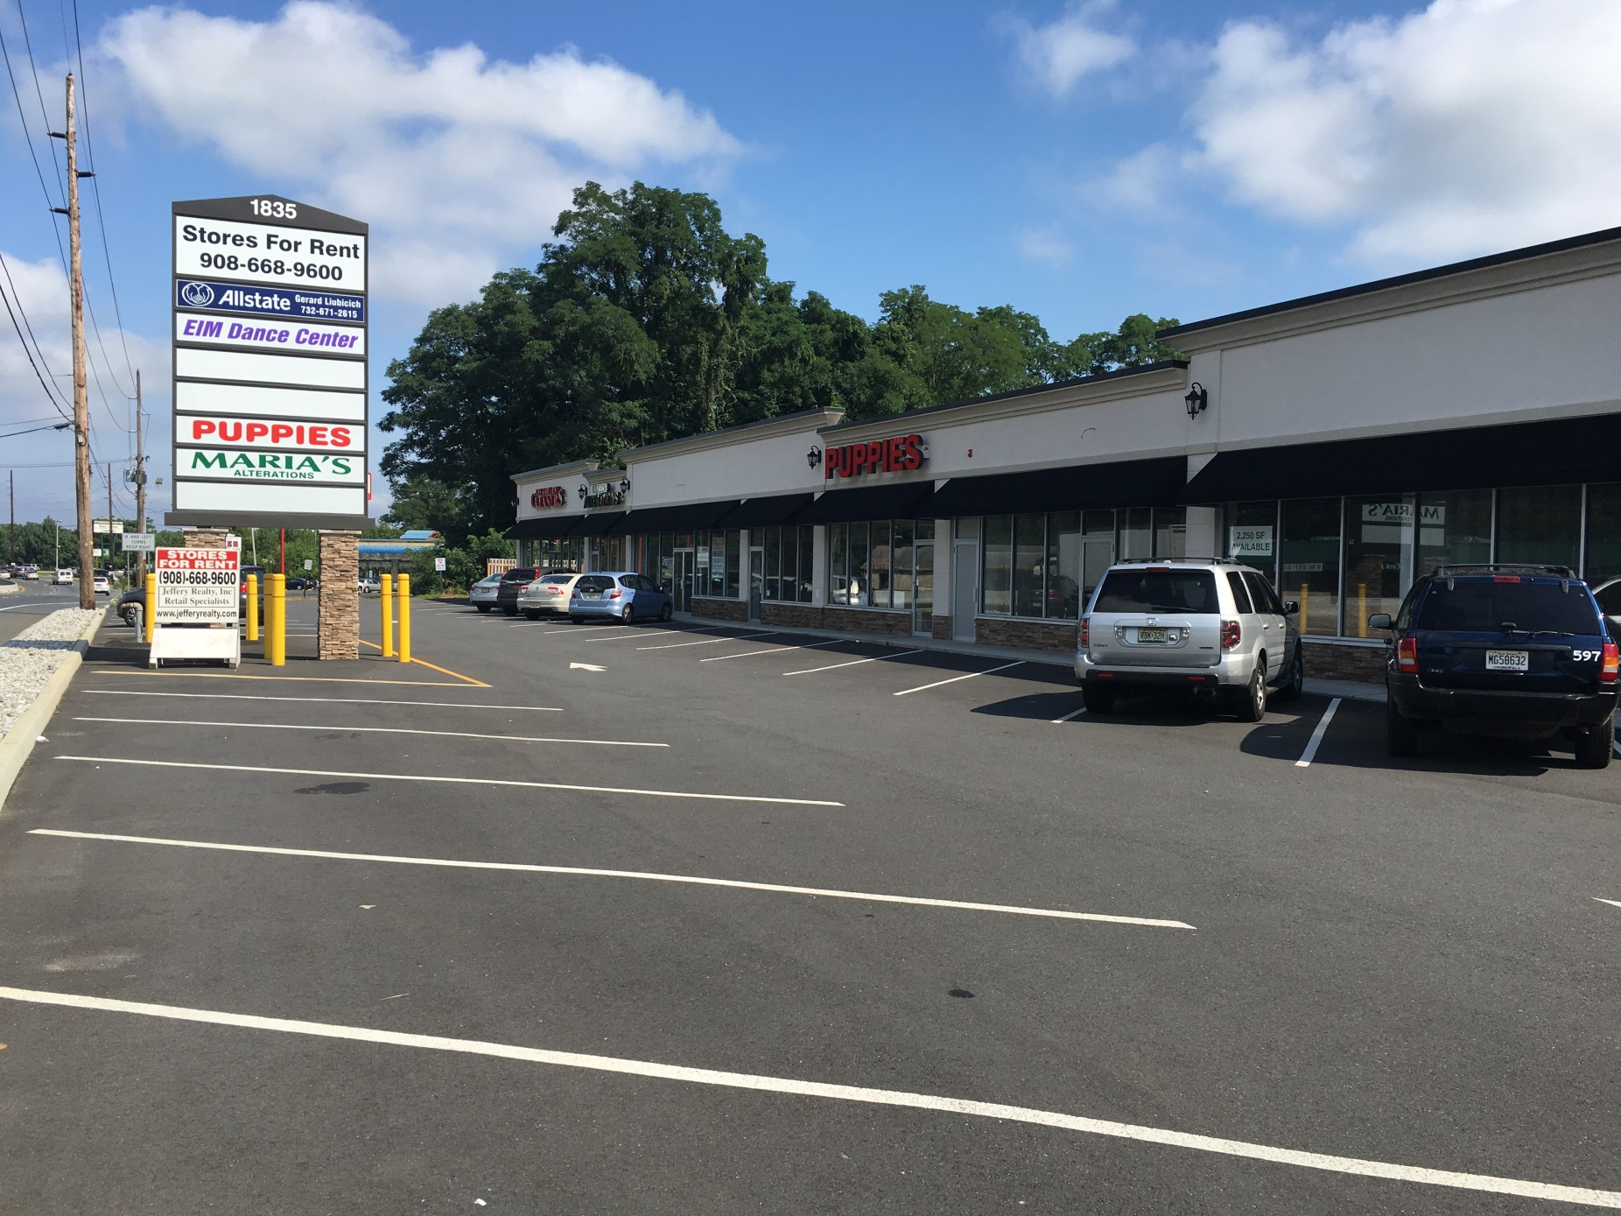
Adler Lumber site – after site and façade improvements

Slide 15
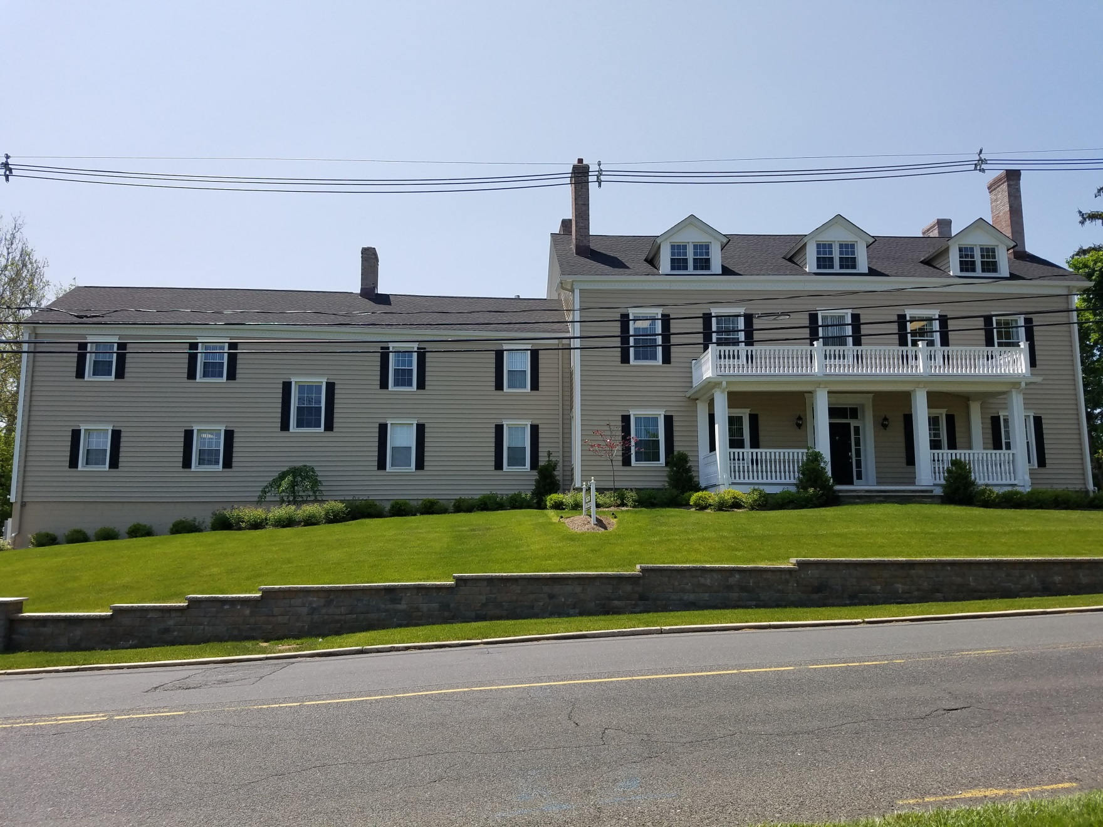
Executive Center – Kings Highway

Slide 16
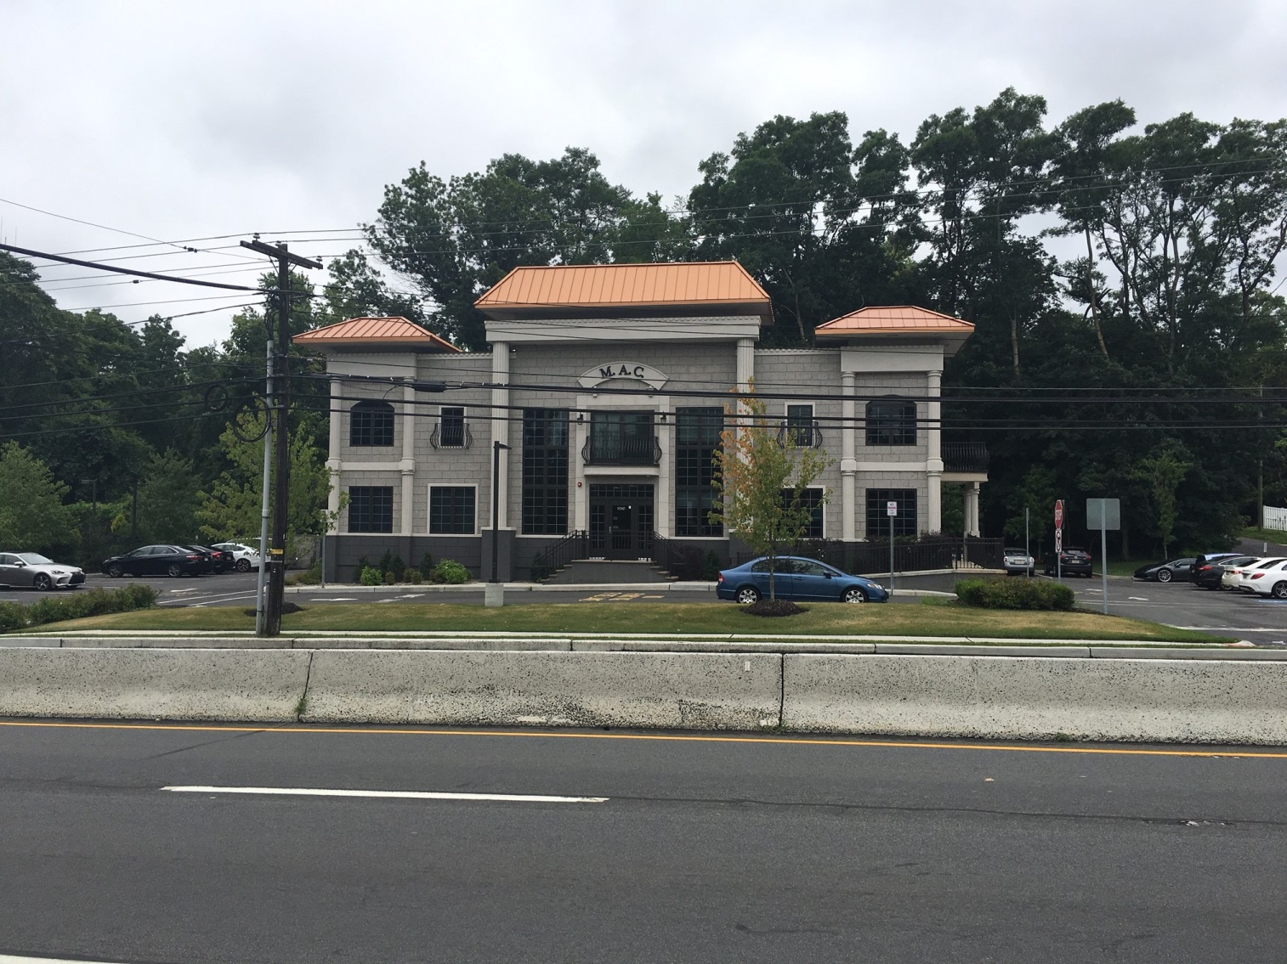
Highway 35 Corridor – Ongoing Development

Slide 17
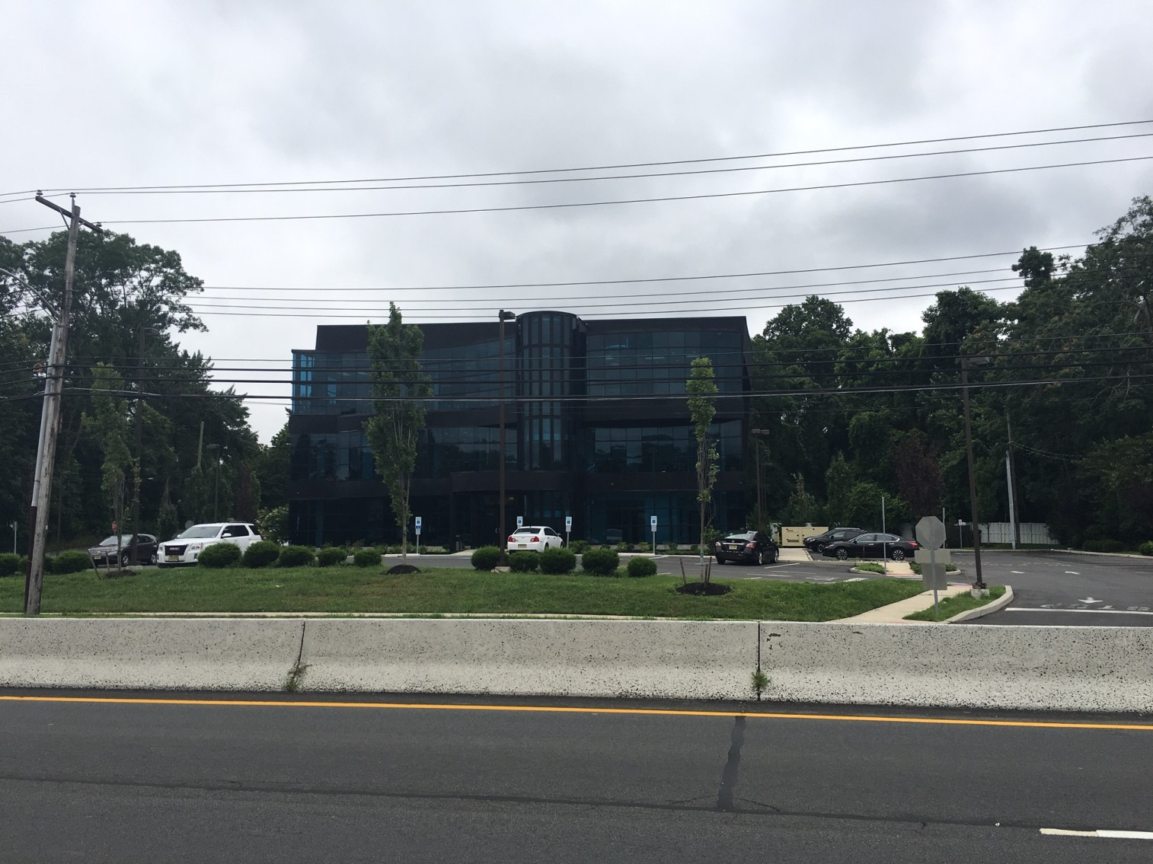
Highway 35 Corridor – Ongoing Development

Slide 18
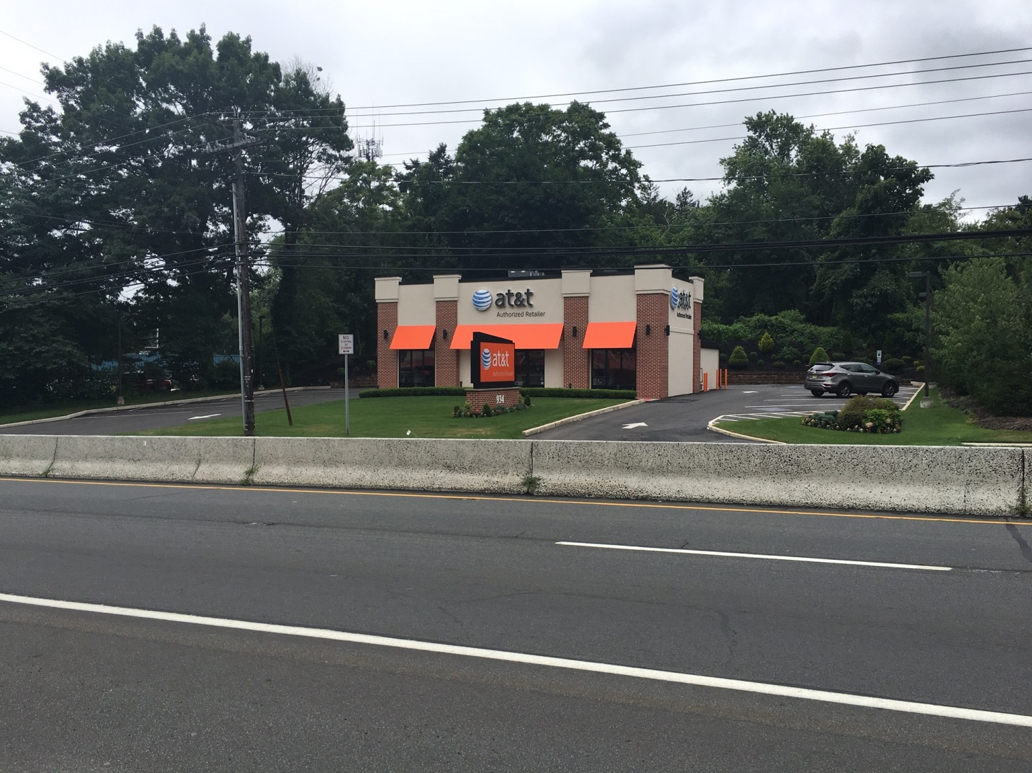
Highway 35 Corridor – Ongoing Development

Slide 19
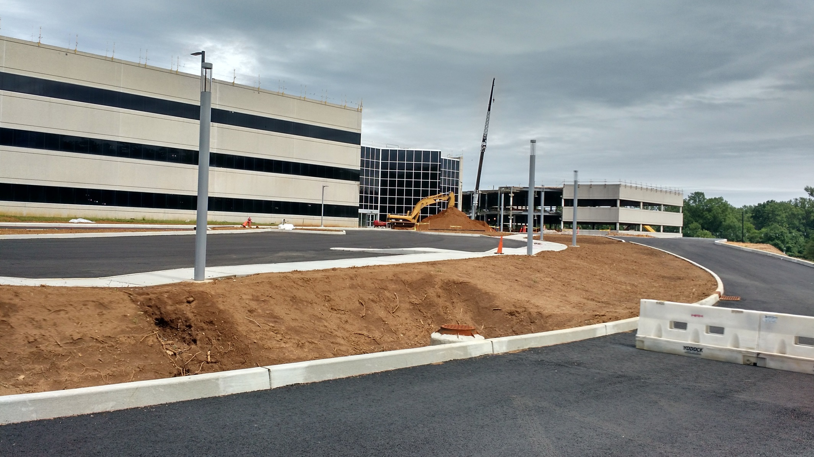
Reuse / Rehabilitation – Memorial Sloan Kettering Cancer Center

Slide 20
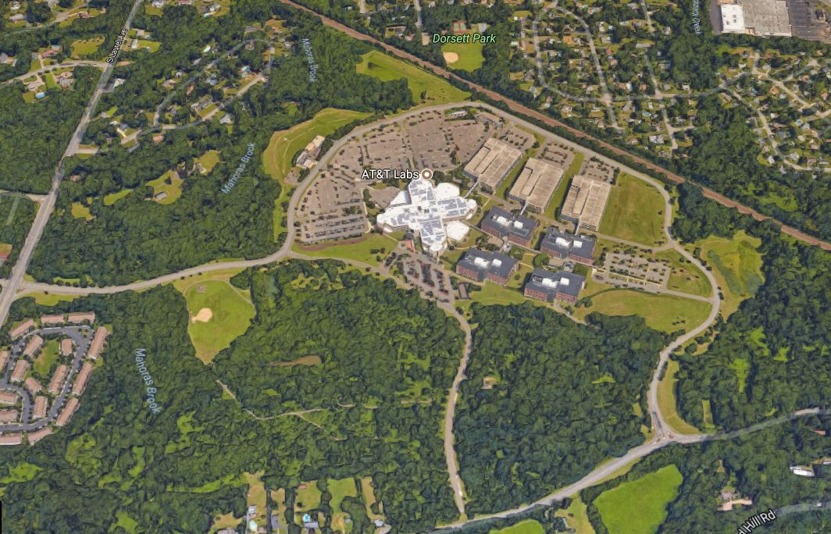
AT&T

Slide 21
Redevelopment Initiatives

Slide 22
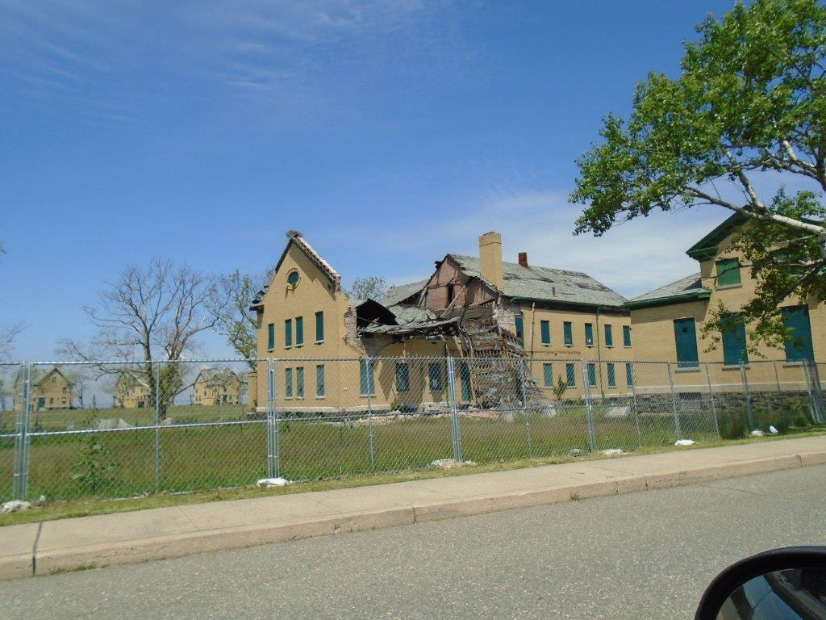
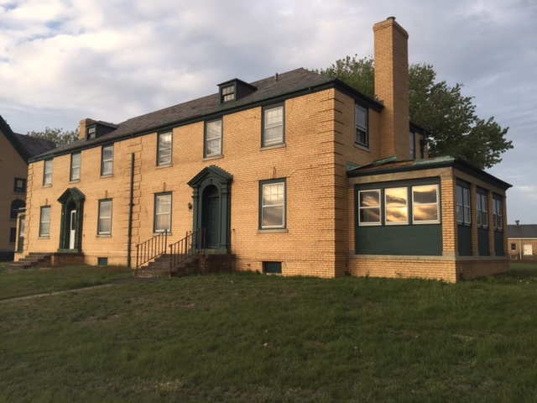
Fort Hancock

Slide 23
What is Redevelopment?
Redevelopment is a planning tool under the New Jersey Local Redevelopment and Housing Law (NJSA 40A: 12A-1 et seq. )

Slide 24
How Does Redevelopment Work?
Rehabilitation and Infill Development take advantage of existing buildings and infrastructure.
Designated Redevelopment Areas can provide incentives and stimulus to encourage projects in areas that meet certain criteria.

Slide 25
Purpose of Redevelopment Projects
Spur Investment and Development
Encourage Creative Use of Underdeveloped Properties
Enhance Tax Base
Create Attractive Destinations

Slide 26
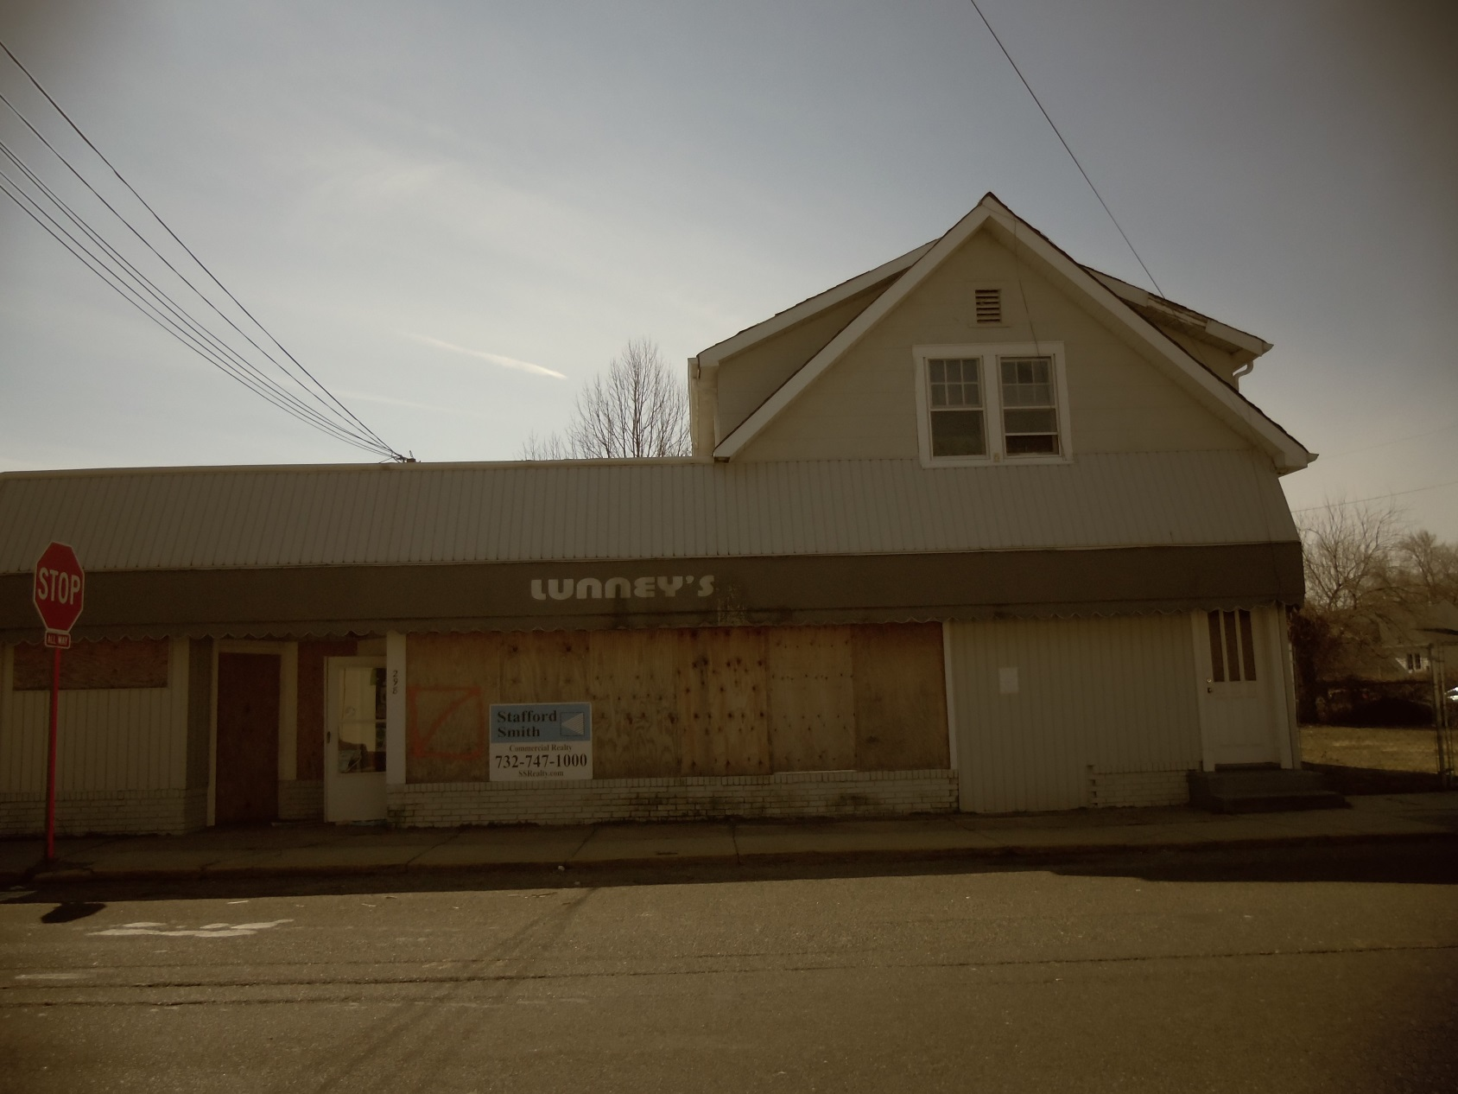
North Middletown Redevelopment Lunney’s Property

Slide 27
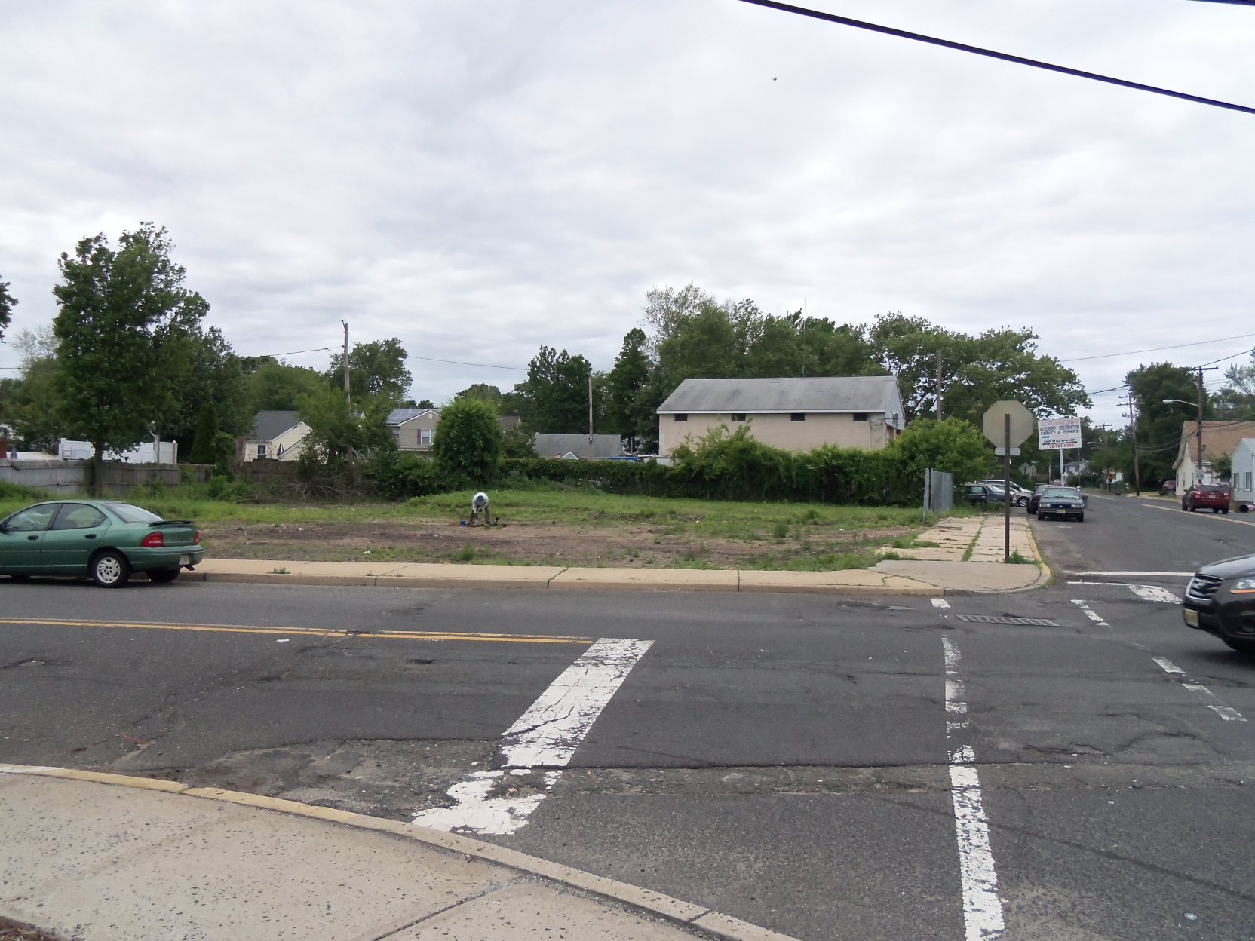
North Middletown Redevelopment Current Conditions

Slide 28
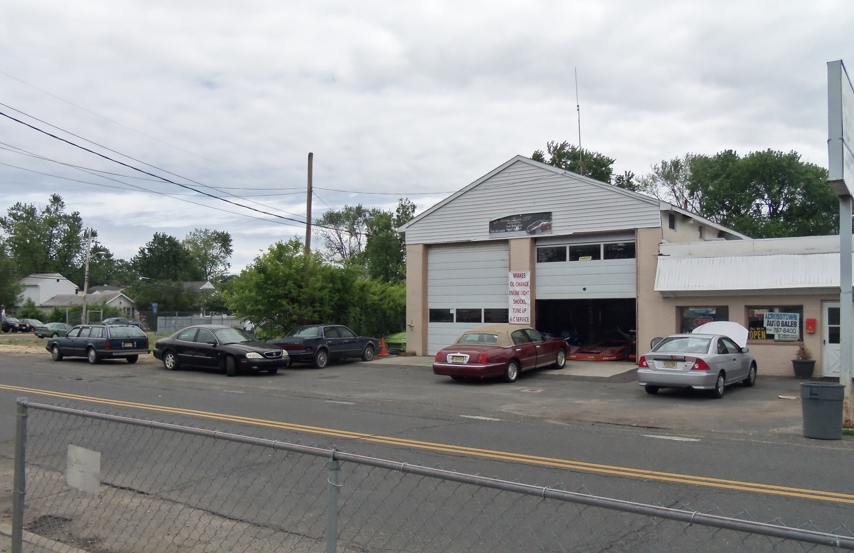
North Middletown Redevelopment Current Conditions

Slide 29
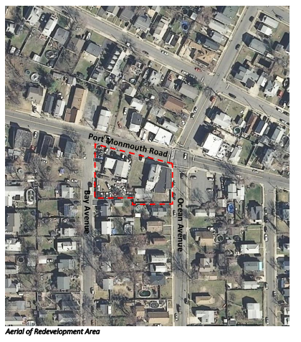
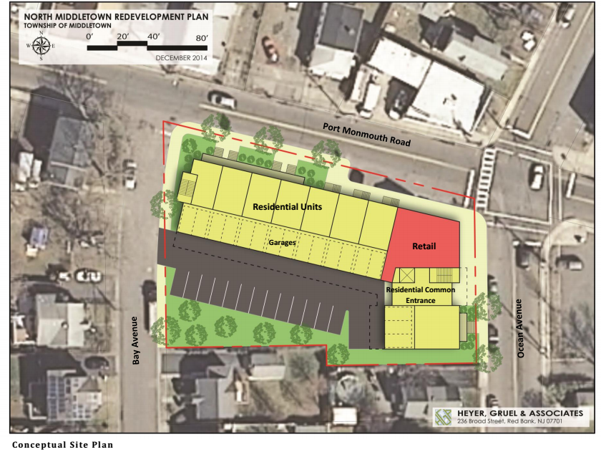
North Middletown Redevelopment Plan
The lots along Port Monmouth Road between Bay and Ocean Avenues in North
Middletown were officially designated as an Area in Need of Redevelopment in
September 2014. The Planning Board worked with a consultant to prepare a
Redevelopment Plan to encourage reuse of this site.

Slide 30
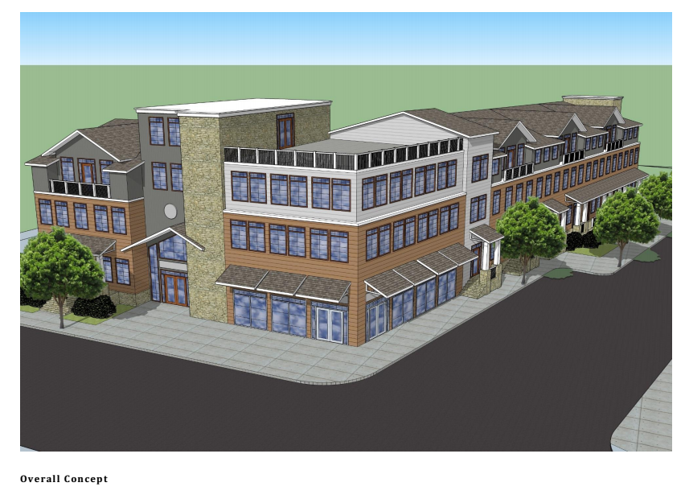
North Middletown Redevelopment Plan
Prepared by Heyer, Gruel & Associates

Slide 31
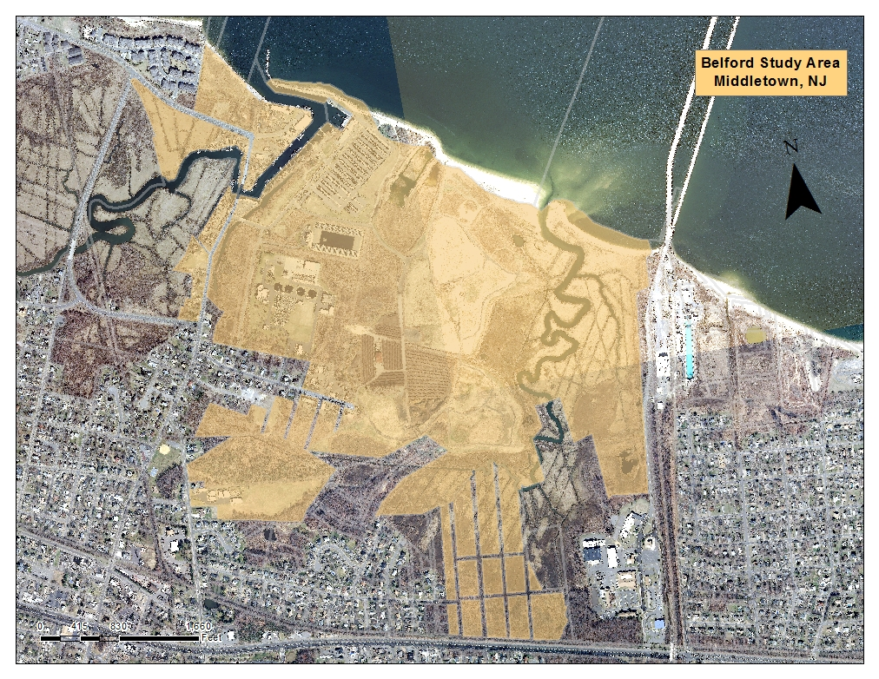
Belford Seaport Redevelopment
Middletown Township recently completed a needs study for a potential redevelopment area at the Belford Seaport and Ferry Terminal area. This was funded by a post Sandy planning grant from the State of New Jersey.

Slide 32
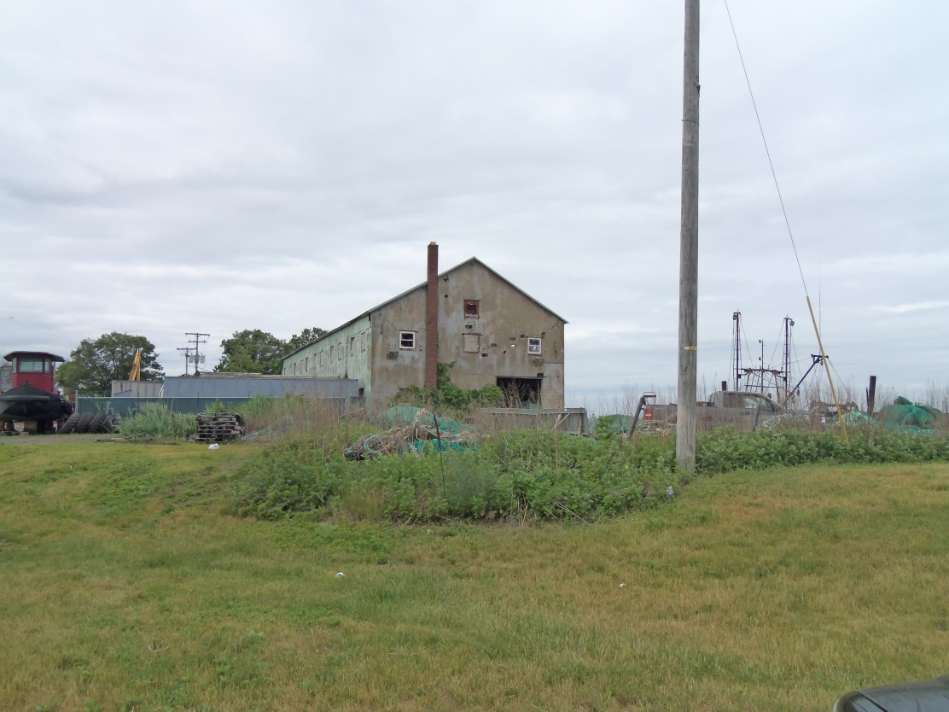
Belford Seaport Redevelopment

Slide 33
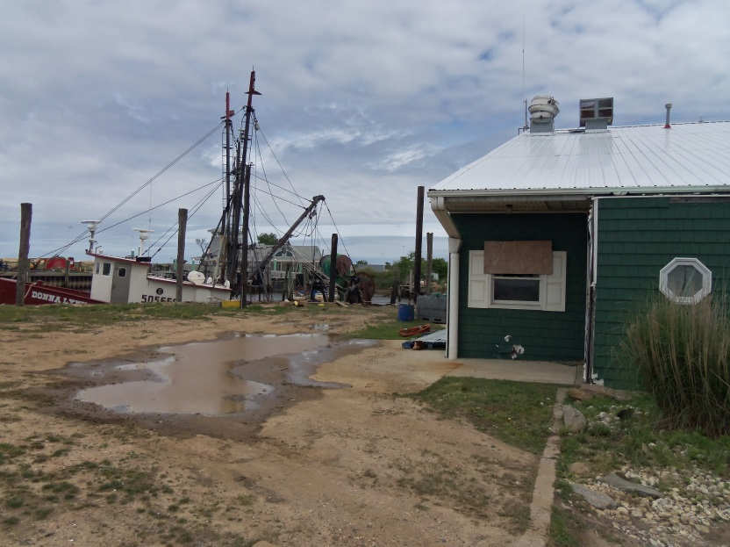
Belford Seaport Redevelopment

Slide 34
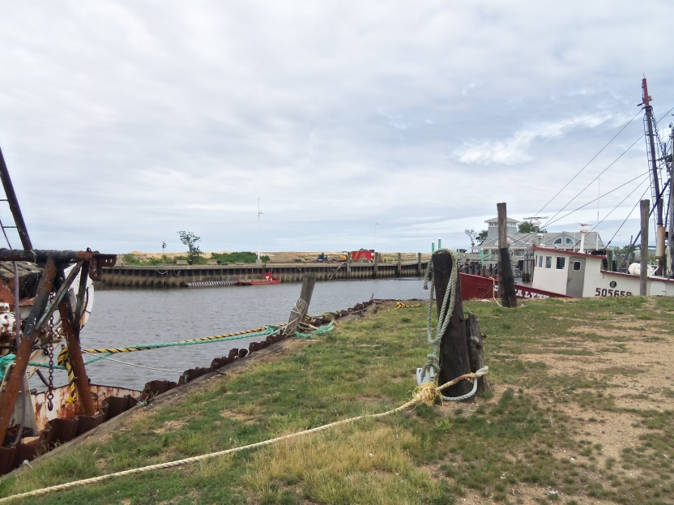
Belford Seaport Redevelopment

Slide 35
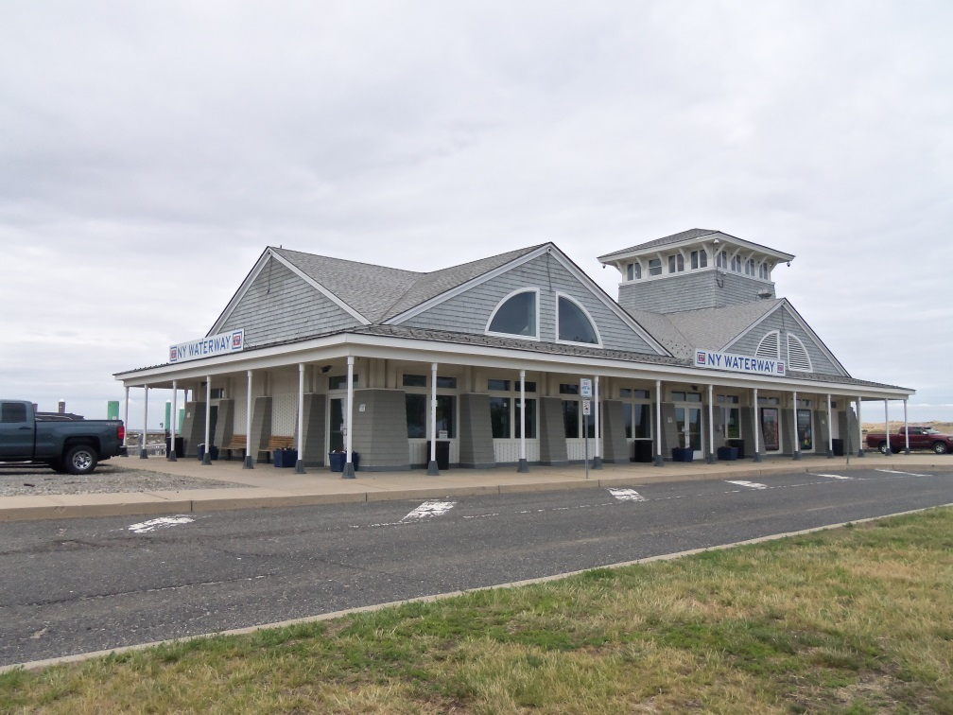
Belford Seaport Redevelopment

Slide 36
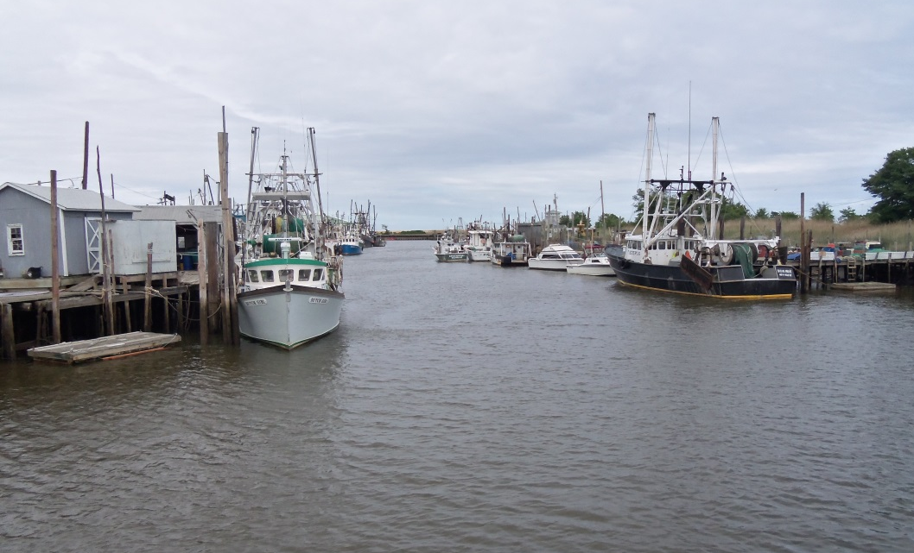
Belford Seaport Redevelopment

Slide 37
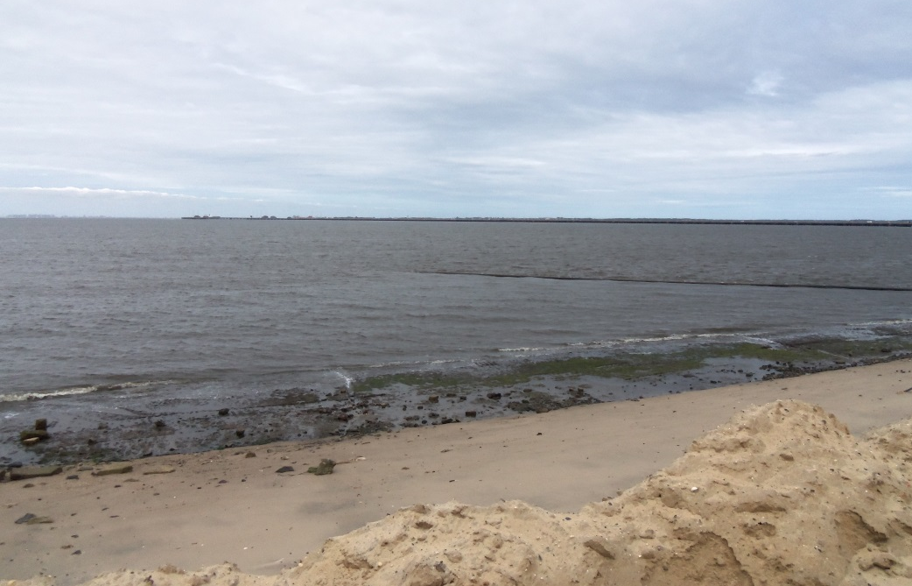
Belford Seaport Redevelopment

Slide 38
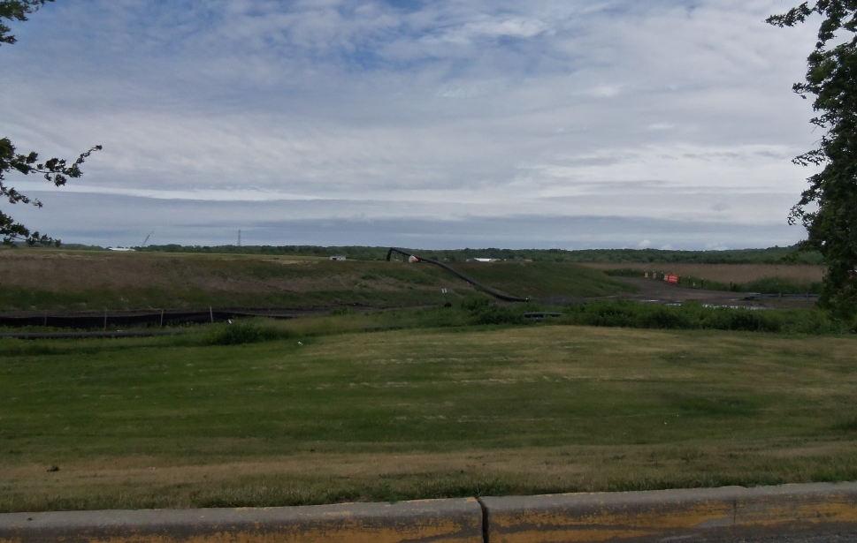
Belford Seaport Redevelopment

Slide 39
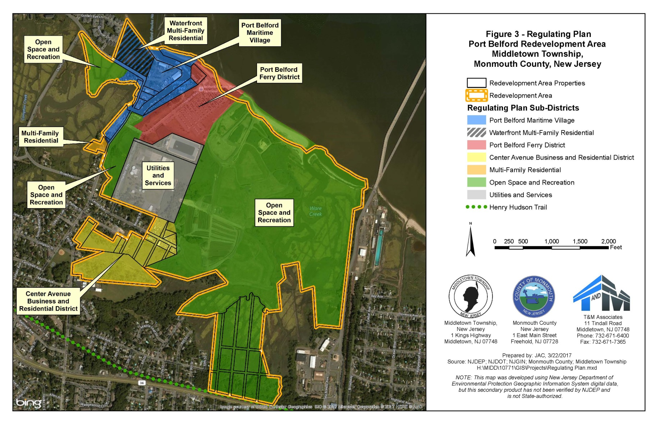
Belford Seaport Redevelopment Plan

Slide 40
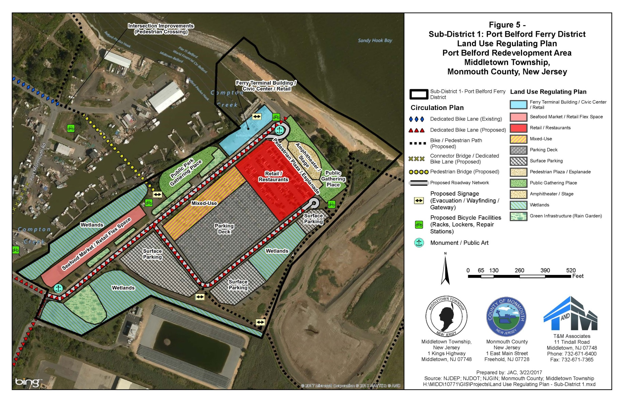
Belford Seaport Redevelopment Plan

Slide 41
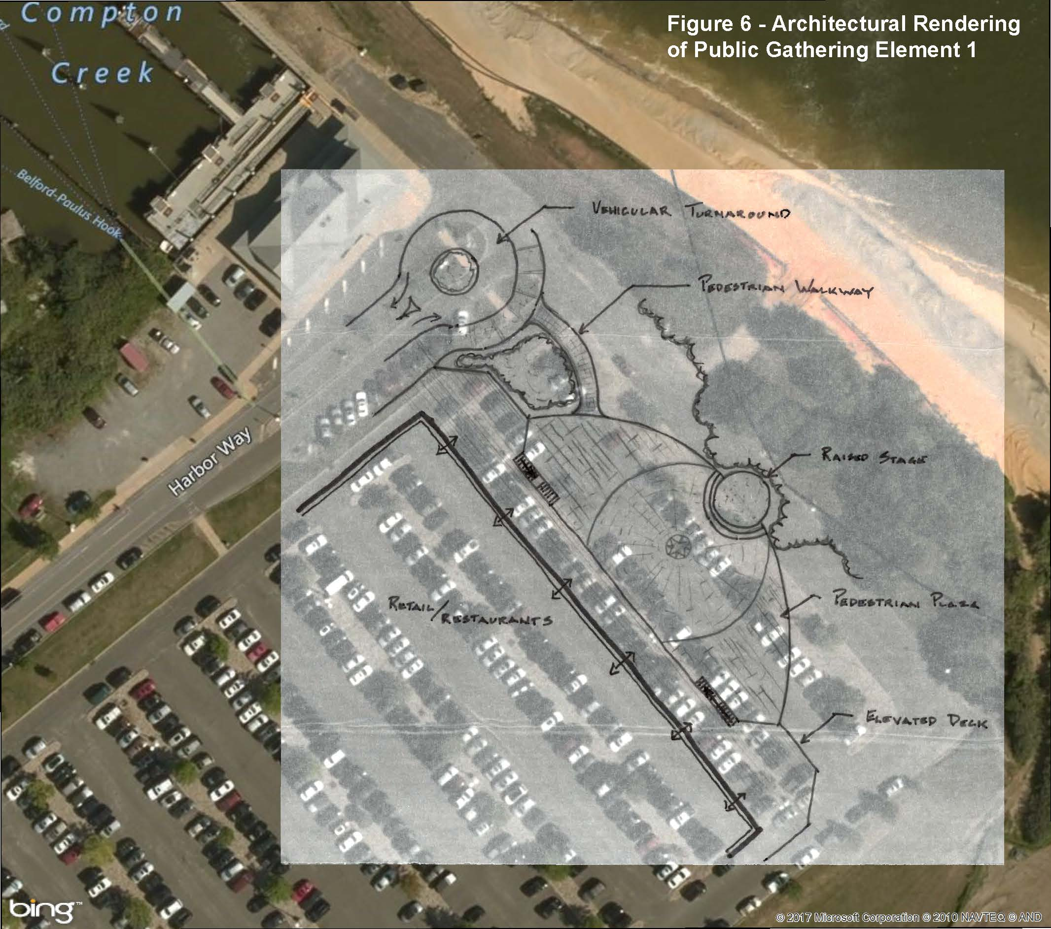
Belford Seaport Redevelopment Plan

Slide 42
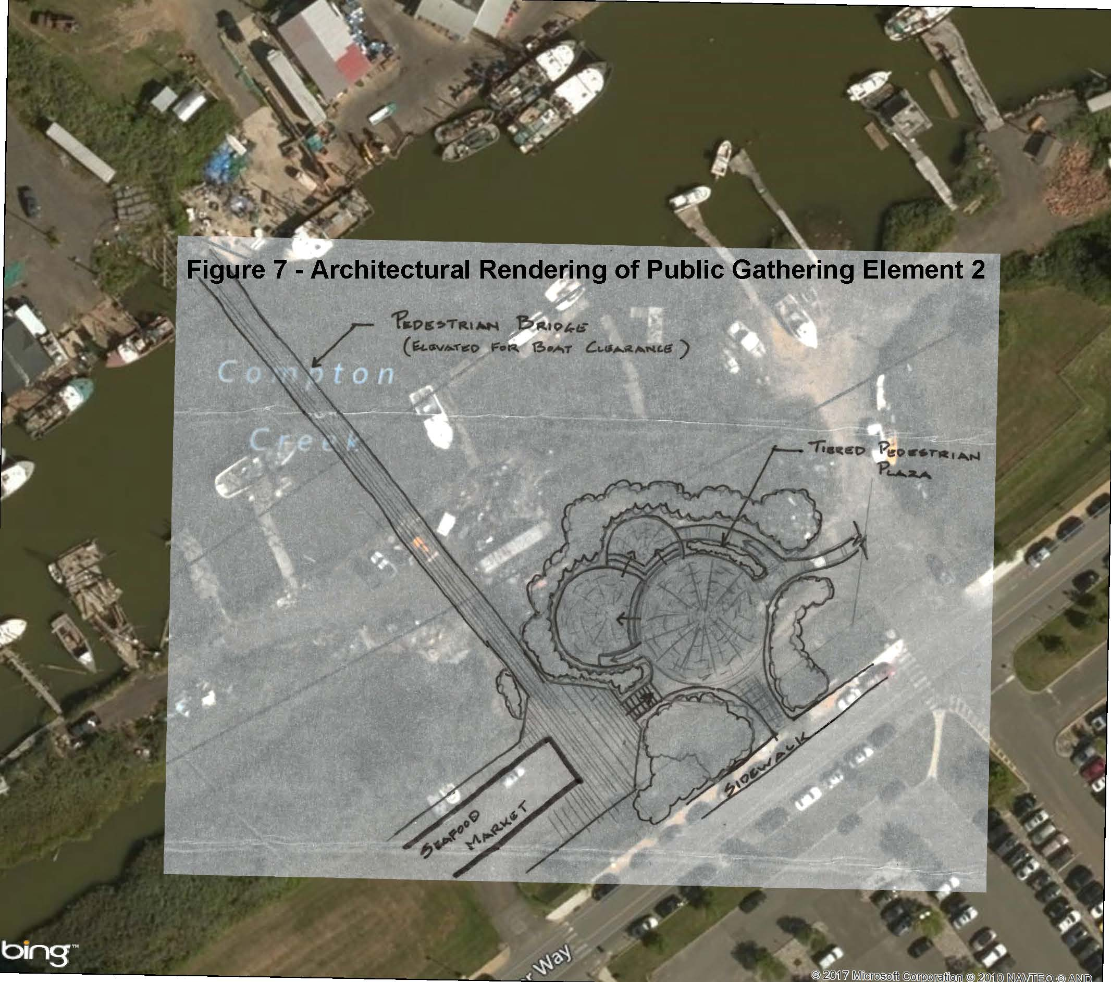
Belford Seaport Redevelopment Plan

Slide 43
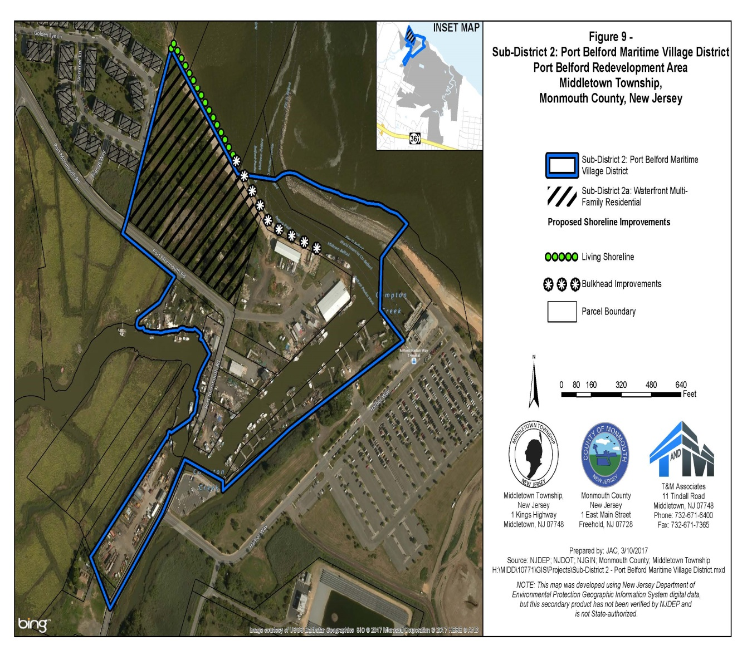
Belford Seaport Redevelopment Plan

Slide 44
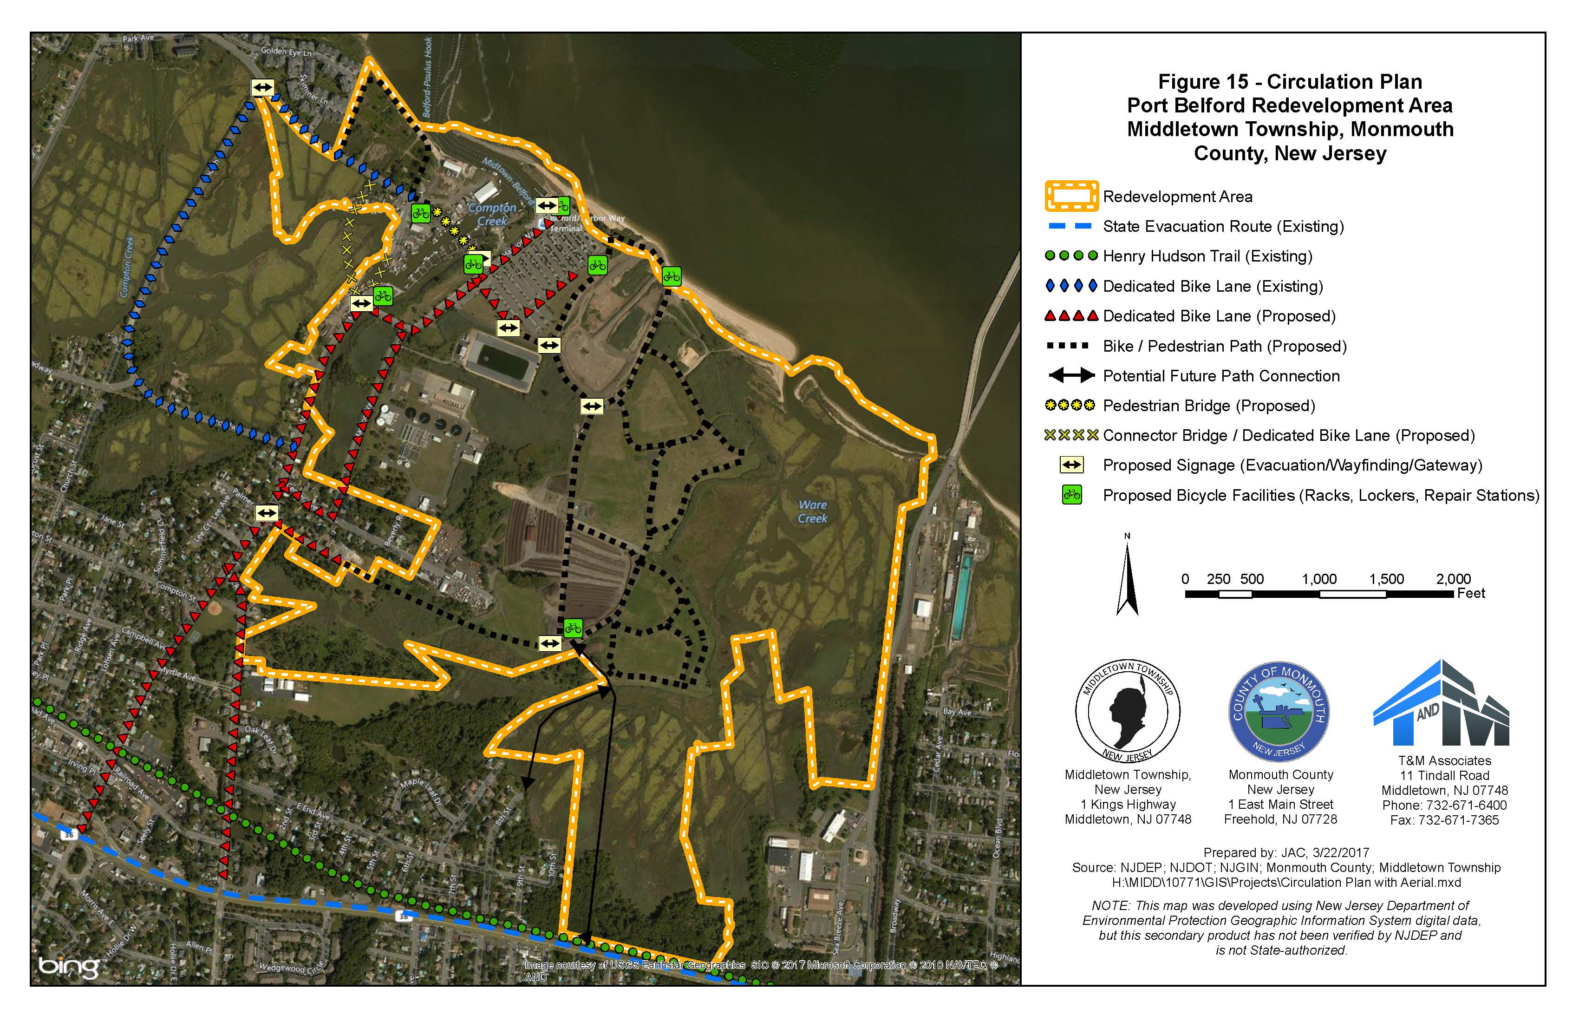
Belford Seaport Redevelopment Plan

Slide 45
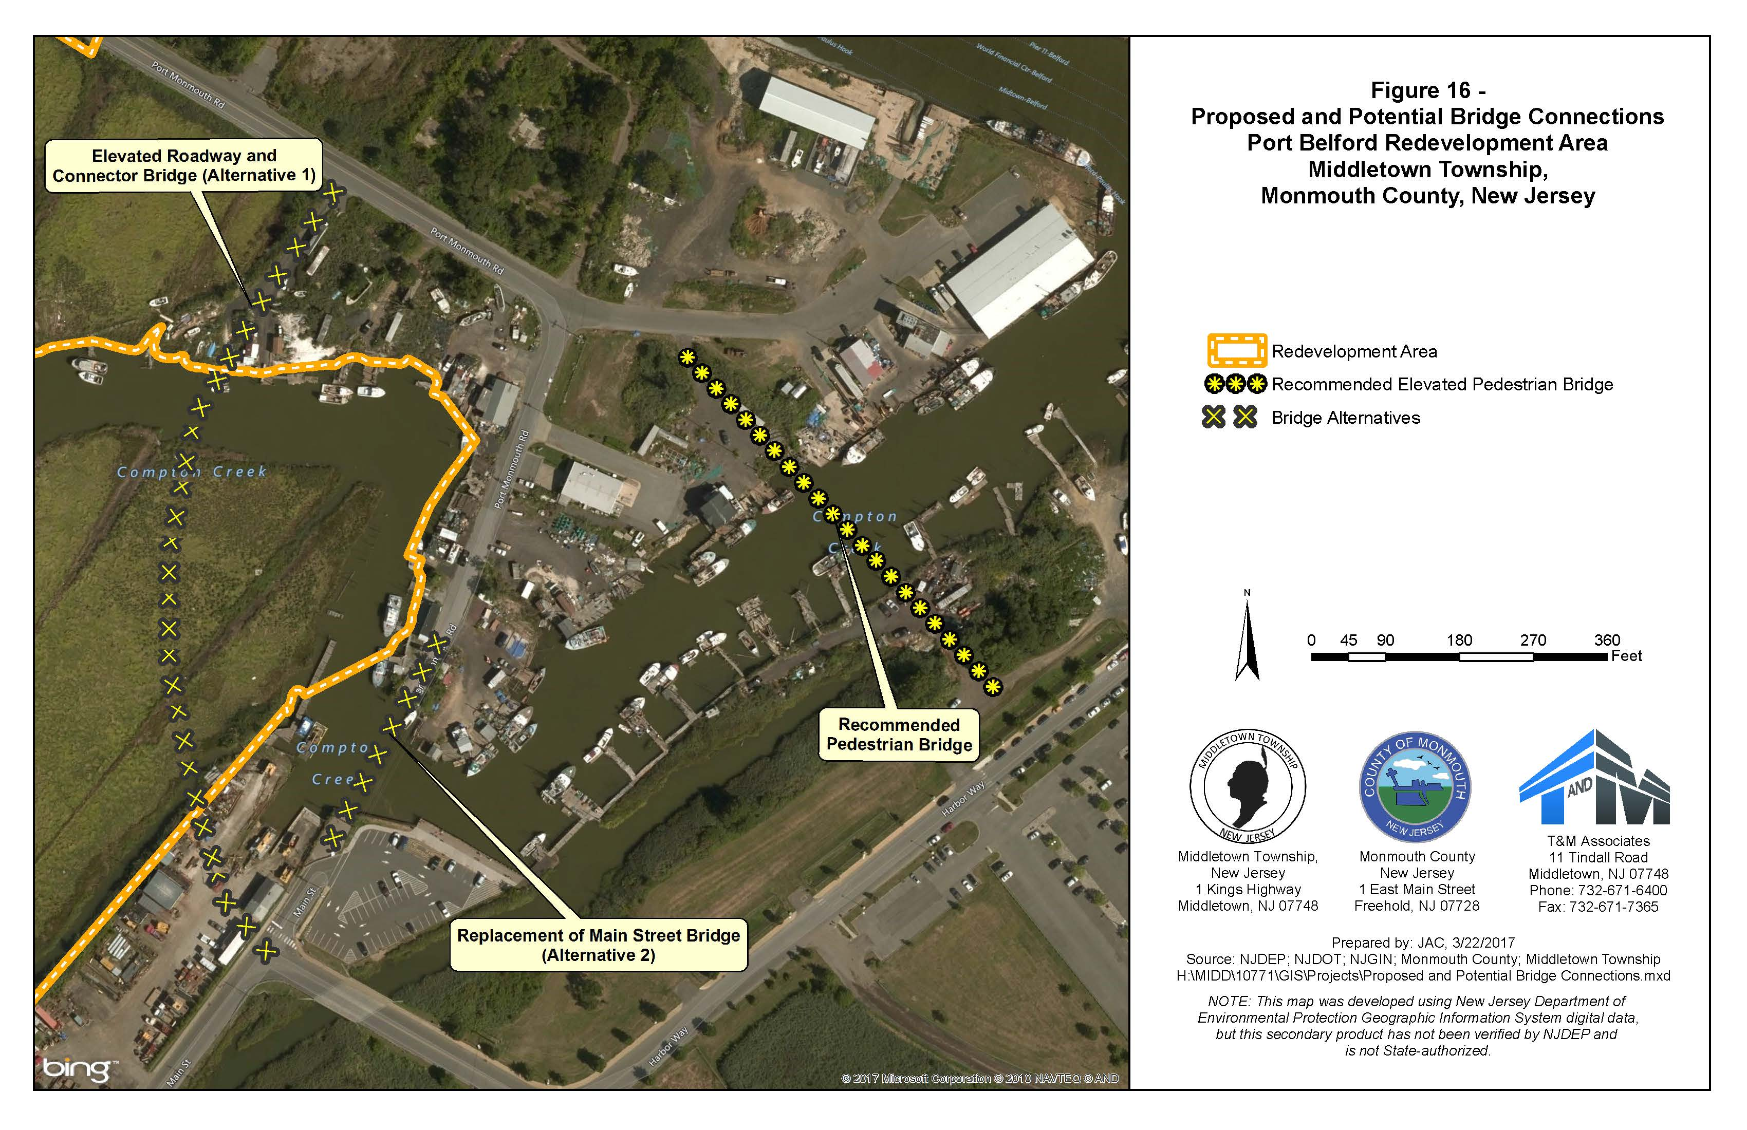
Belford Seaport Redevelopment Plan

Slide 46
Why can’t the township amend its zoning ordinances to prevent development?

Slide 47
Why can’t Middletown refuse to build affordable housing?

Slide 48
Affordable Housing Projects
Middletown has never been an exclusionary community but is required by the State regulations to provide affordable housing.
Middletown has conducted the following initiatives to be in compliance with the State requirement.

Slide 49
Affordable Housing Projects
List of Affordable Projects to comply with the State's regulations
Existing Projects | Total Units | Market Rate | Affordable Units | % of Affordable to Total units
Beacon Place | 140 | 112 | 28 | 20%
Regency Park | 110 | 94 | 16 | 15%
Chapel Hill | 150 | 120 | 30 | 20%
Park Avenue Condos (Off site Shoal Harbor Crossing) | 30 | 24 | 6 | 20%
Harmony Glen | 90 | 72 | 18 | 20%
Laurel Greene | 118 | 94 | 24 | 20%
Browns Landing / Middletown Crossing | 21 | 19 | 2 | 10%
Cottage Gate | 105 | 92 | 13 | 12%
Conifer Senior Housing | 180 | 0 | 180 | 100%
Luftman Pavilion Senior Housing | 60 | 0 | 60 | 100%
33 Vanderbilt Avenue (Residential and commercial) | 15 | n/a | 15 | -
Bayshore Village | 100 | 0 | 100 | 100%
Proposed Projects | Total Units | Market Rate | Affordable Units | % of Affordable to Total units
Schwartz/Taylor Lane/American properties | 245 | 196 | 49 | 20%
Mountain Hill | 350 | 280 | 70 | 20%
Atlantic Pier | 40 | 30 | 10 | 25%
Meadowview | 38 | 29 | 9 | 24%
Sites Zoned to contain affordable units | Total Units | Market Rate | Affordable Units | % of Affordable to Total units
Steiner & Frustacci | 139 | 104 | 35 | 25%
199 Laurel Assoc. (Steiner) | 46 | 37 | 9 | 20%
Mogas (Residential Over Commercial) | 12 | n/a | 12 | -
Whirl (Residential Over Commercial) | 2 | n/a | 2 | -
Rosen (Residential Over Commercial) | 8 | n/a | 8 | -

Slide 50
Middletown Demographic, school, and land use data

Slide 51
Demographic Information
Year | Middletown | Keansburg | Hazlet | Holmdel | Atlantic Highlands | Red Bank | Combined Population
1960 | 39,675 | 6,854 | 15,334 | 2,959 | 4,119 | 12,482 | 81,423
1970 | 54,623 | 9,720 | 22,239 | 6,117 | 5,102 | 12,847 | 110,648
1980 | 62,574 | 10,613 | 23,013 | 8,447 | 4,950 | 12,031 | 121,628
1990 | 68,183 | 11,069 | 21,976 | 11,532 | 4,629 | 10,636 | 128,025
2000 | 66,327 | 10,732 | 21,378 | 15,781 | 4,705 | 11,844 | 130,767
2010 | 66,522 | 10,105 | 20,334 | 16,773 | 4,385 | 12,206 | 130,325

Slide 52
Demographic Information (contd)

Slide 53
Middletown Township School District Enrollment
Year | Enrollment | Year to Year Change (%)
2006-2007 | 10,130.00 | -
2007-2008 | 10,142.00 | 0.1%
2008-2009 | 10,093.50 | -0.5%
2009-2010 | 10,288.00 | 1.9%
2010-2011 | 10,263.00 | -0.2%
2011-2012 | 9,934.50 | -3.2%
2012-2013 | 9,834.50 | -1.0%
2013-2014 | 9,733.50 | -1.0%
2014-2015 | 9,645.00 | -0.9%
2015-2016 | 9,628.00 | -0.2%
2016-2017 | 9,564.00 | -0.7%
Source: NJ Department of Education website http://www.nj.gov/education/; accessed on July 21, 2017

Slide 54
Middletown Property Values and Tax Revenue
Land Use Category | Total Assessed Value | % of the Grand Total | Taxes @ $2.124 | Avg. Assessment | Approx. # | Avg. per unit
Vacant land | $ 119,256,100.00 | 1.01% | $ 2,532,999.56 | $ 97,351 | 1225 | $ 2,067
Residential 1-4 Family | $ 9,318,653,150.00 | 78.61% | $ 197,928,192.91 | $ 413,739 | 22,523 | $ 8,787
Exempt-15A | $ 258,496,300.00 | 2.18% | $ - | $ - | - | $ -
15B | $ 42,544,900.00 | 0.36% | $ - | $ - | - | $ -
15C | $ 605,071,100.00 | 5.10% | $ - | $ - | - | $ -
15D | $ 115,132,400.00 | 0.97% | $ - | $ - | - | $ -
15E | $ 39,007,300.00 | 0.33% | $ - | $ - | - | $ -
15F | $ 105,382,200.00 | 0.89% | $ - | $ - | - | $ -
Farm Home | $ 130,307,000.00 | 1.10% | $ 2,767,720.68 | $ 904,909 | 144 | $ 19,220
Farmland | $ 647,700.00 | 0.01% | $ 13,757.15 | $ 7,531 | 86 | $ 159
Commercial | $ 995,704,500.00 | 8.40% | $ 21,148,763.58 | $ 1,693,375 | 1146 | $ 18,454
Industrial | $ 2,681,700.00 | 0.02% | $ 56,959.31 | $ 2,681,700 | 1 | $ 56,959
Apartments | $ 108,541,700.00 | 0.92% | $ 2,305,425.71 | $ 7,752,978 | 1020 | $ 2,260
Phone Lines | $ 13,247,803.00 | 0.11% | $ 281,383.34 | $ - | - | $ -
Grand Total | $ 11,854,673,853.00 | 100.00% | $ 227,035,202.23

Slide 55
What has Middletown done to control development in town?

Slide 56
What can residents do to help the township control overdevelopment?
Review the zoning ordinances that govern development on the proposed property and the proposed plans.
If you oppose an application, have concrete reasons and facts based on conflicts with current rules, regulations and laws, as to why the application should be turned down. Just saying you do not want it is not grounds for denying an application. Just saying it’s going to cause more traffic, is not grounds for turning it down.
Whenever possible, provide expert testimony to support your position.
Always remember to present your position in a respectful manner. Insults or threats will only damage what may be a very legitimate objection and actually make it even more difficult for a board to deny an application.

Slide 57
Questions or Comments?

